Slide 1
1
The following slides are screenshots of the steps for reviewing the EQRS systems roles assigned to your EIDM account ID.
Updated 12/21/2017

Slide 2
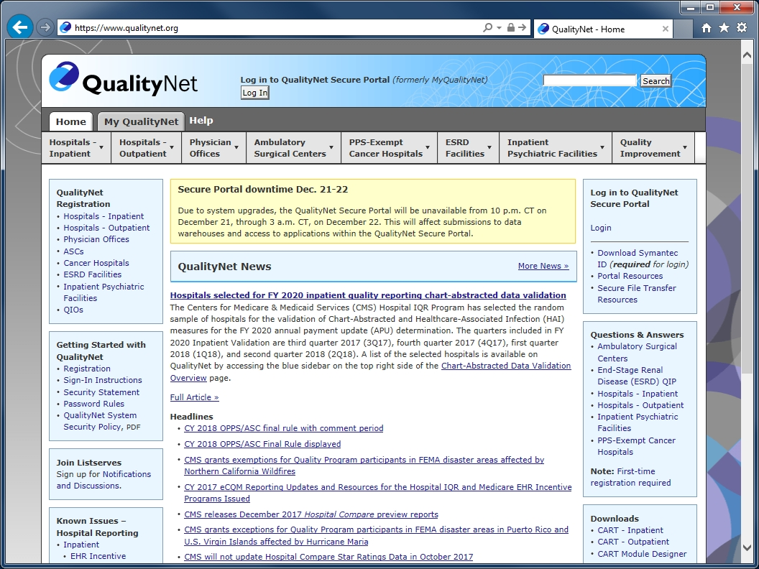
2
Log in at www.qualitynet.org

Slide 3
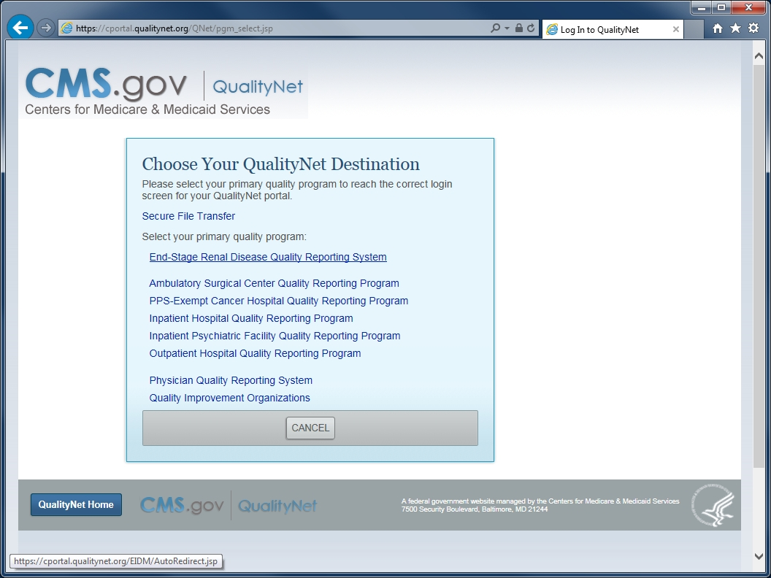
3
Click on the link, End-Stage Renal Disease Quality Reporting System

Slide 4
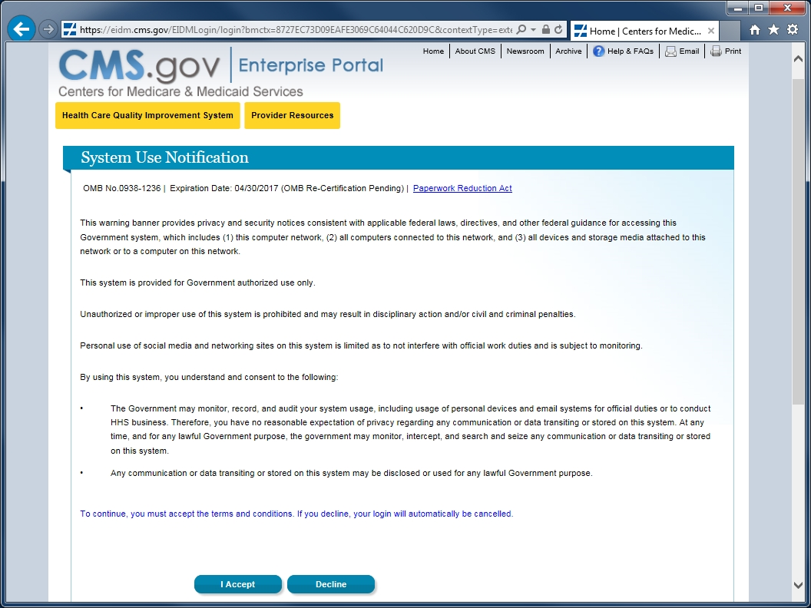
4
Accept the terms and conditions.

Slide 5
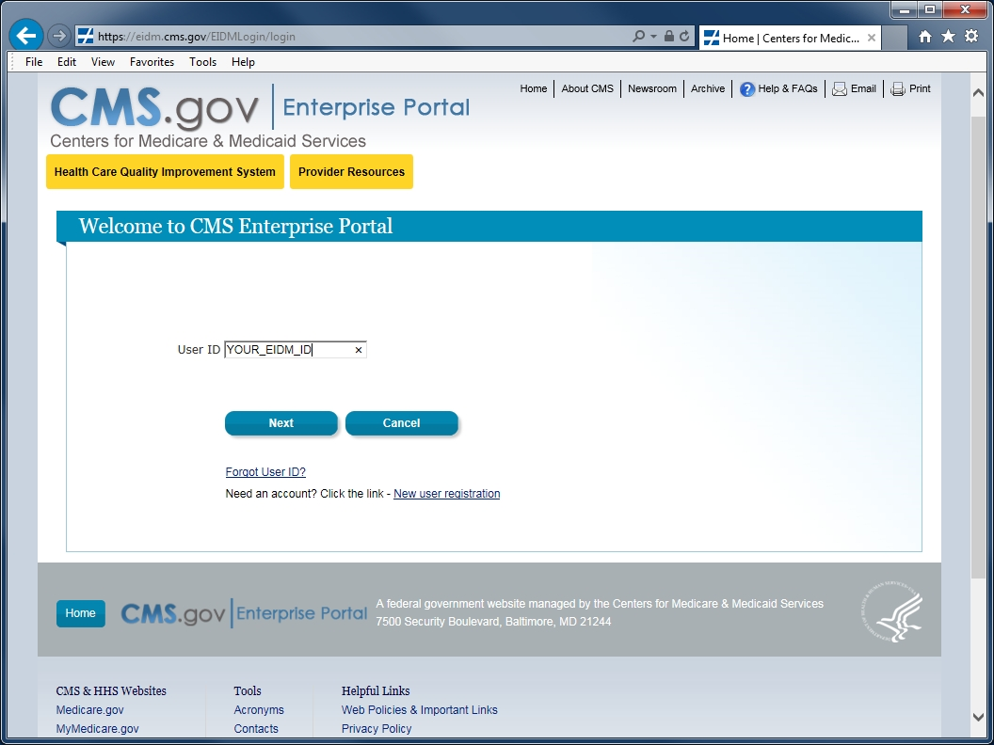
5
Enter your EIDM account ID and click Next.

Slide 6
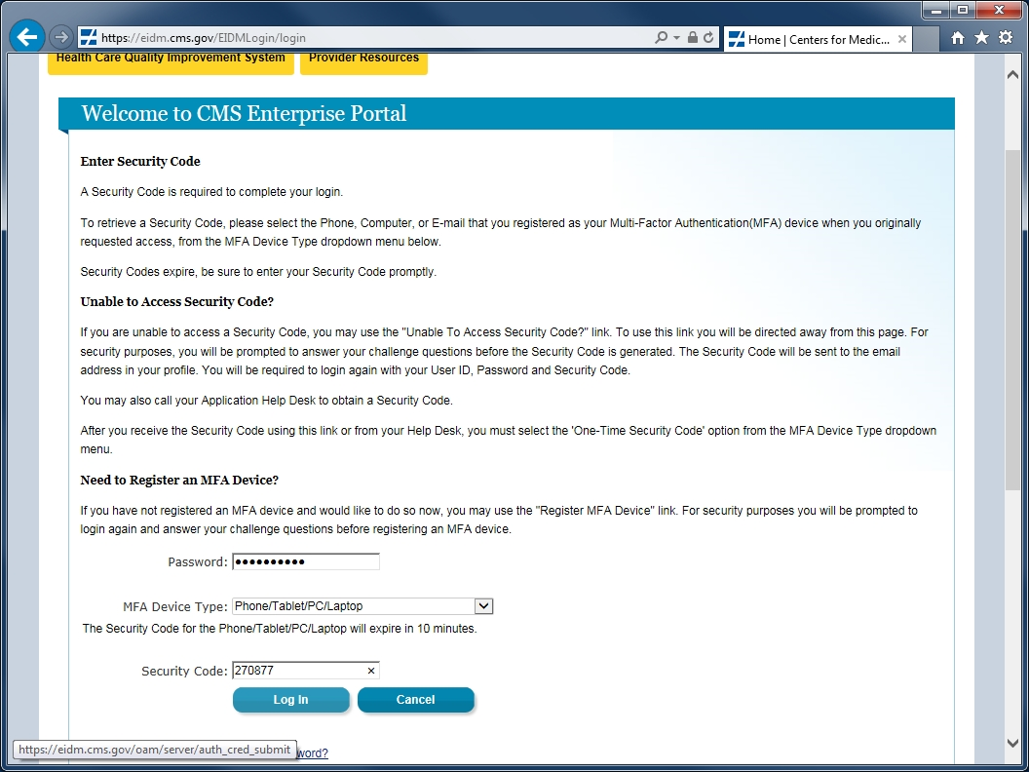
6
Enter your password, select your MFA device method, then enter the security code and click Log In.

Slide 7
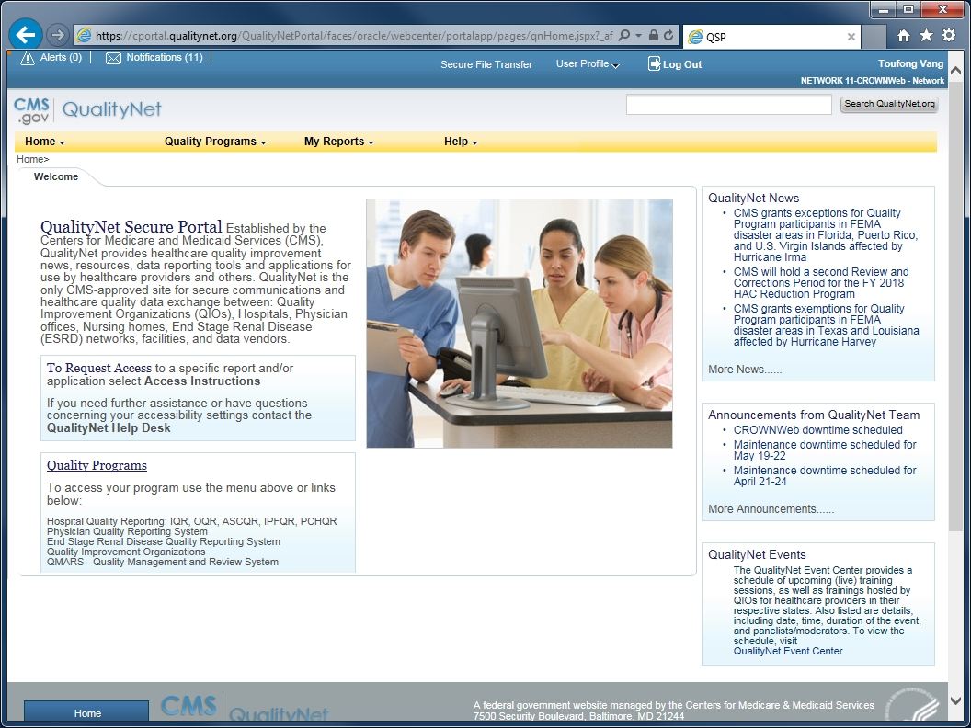
7
The QualityNet Secure Portal home page loads upon your successful sign-in.

Slide 8
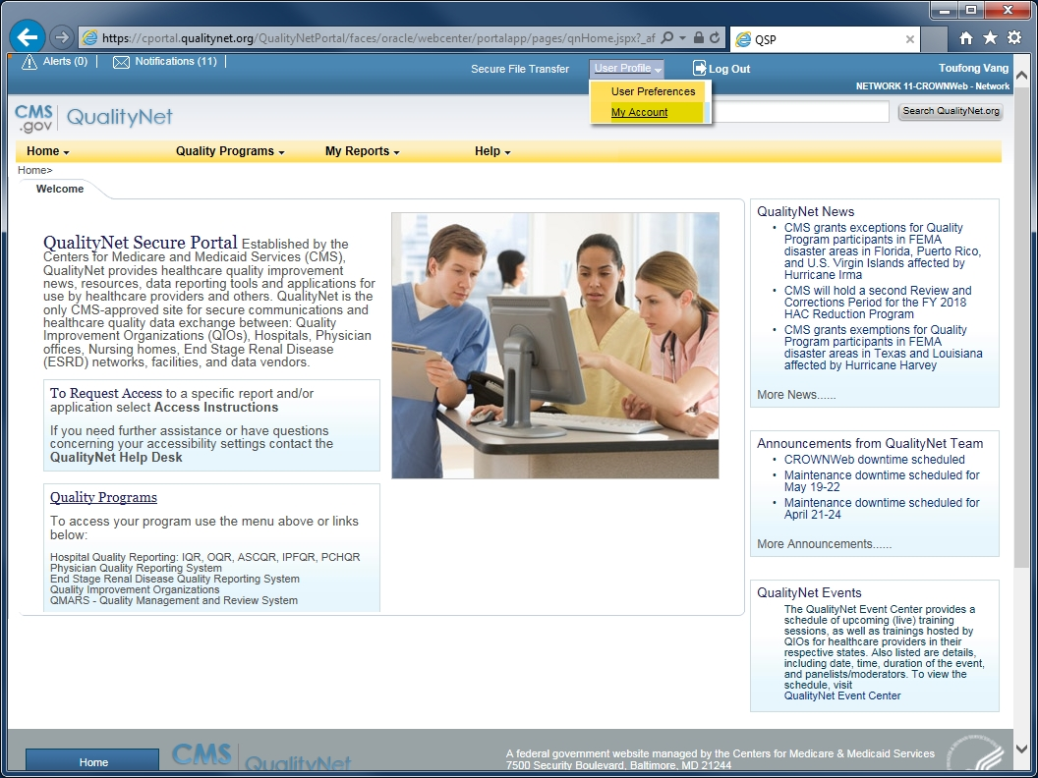
8
Click on User Profile and select
My Account from the drop-list.

Slide 9
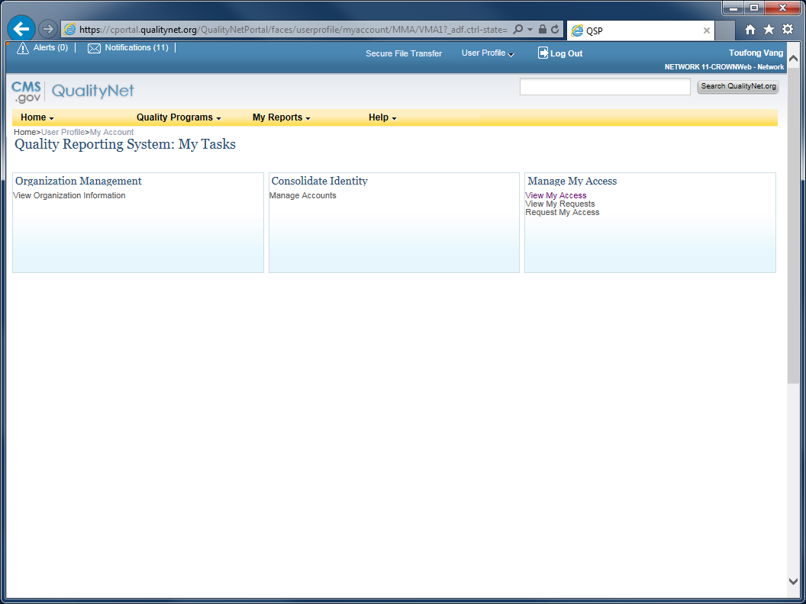
9
Click View My Access located in the group, Manage My Access.

Slide 10
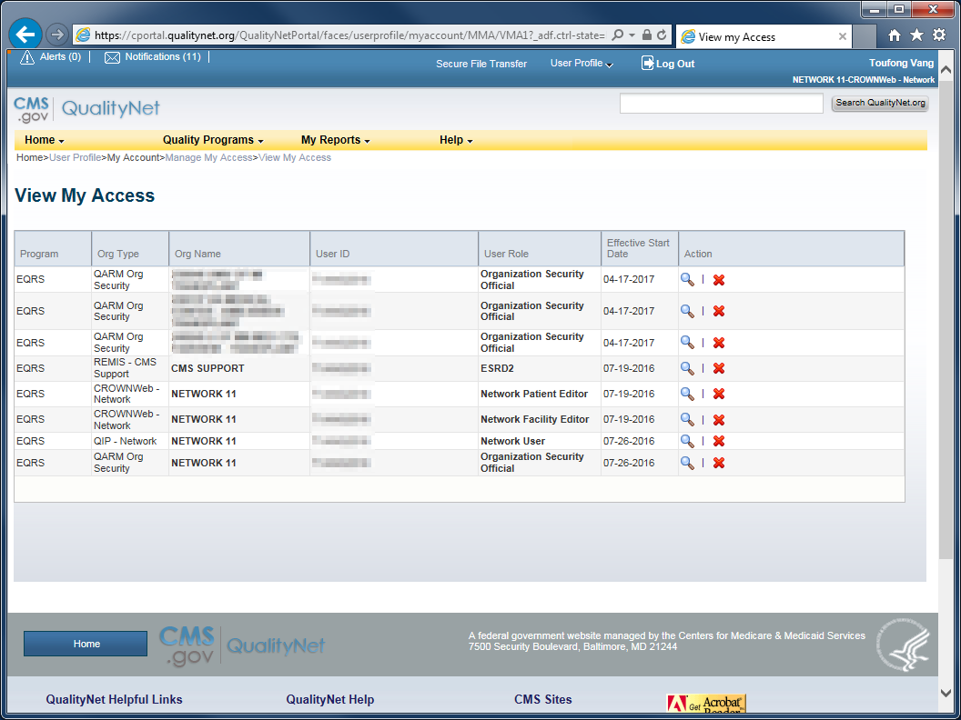
10
The Org Type column indicates the information system to which you have access.
The User Role column indicates the access level (“roles”) that you have to that system.

Slide 11
11
Additional Resources:
EIDM and QARM Quick Start Guide
http://mycrownweb.org/wp-content/uploads/2016/07/EIDM_QARM_Registration_Process_Final_V.pdf
EIDM and QARM Webinar Recording
http://mycrownweb.org/assets/Webex/eidm
EIDM FAQs
https://portal.cms.gov/wps/portal/unauthportal/faq

