Slide 1
1
The following slides are screenshots of the steps for reviewing and revoking a user’s access to EQRS applications.

Slide 2
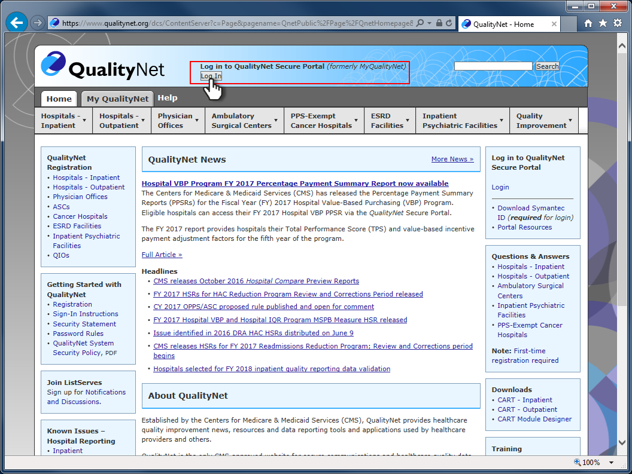
2
Log in at www.qualitynet.org

Slide 3
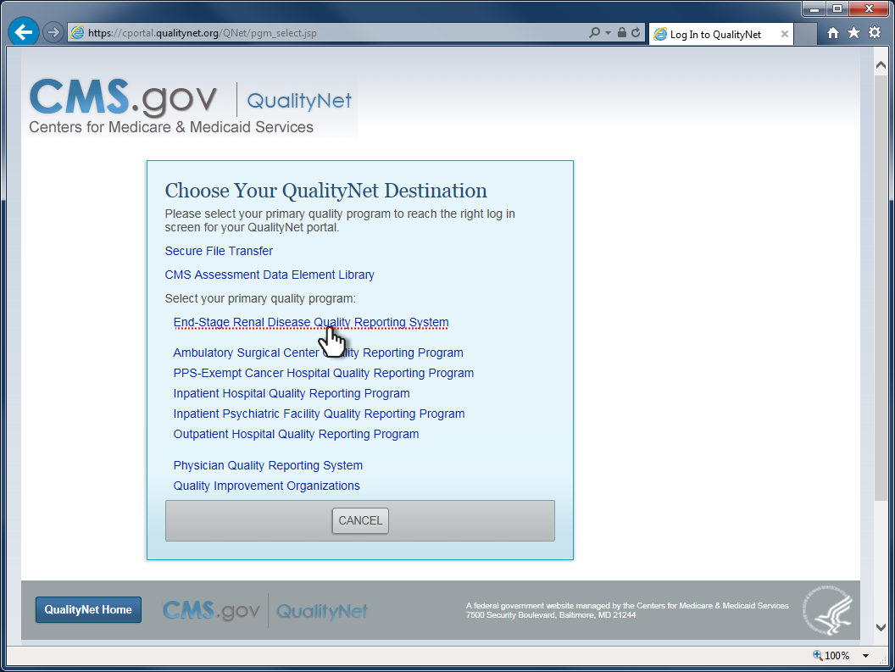
3
Click on the link, End-Stage Renal Disease Quality Reporting System

Slide 4
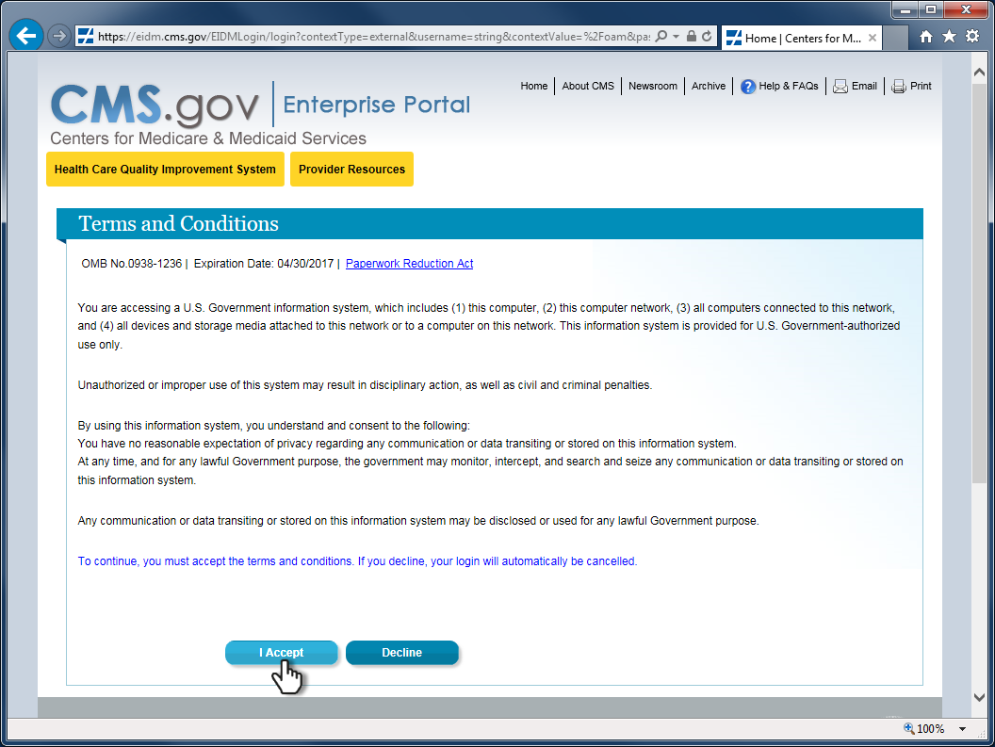
4
Accept the terms and conditions.

Slide 5
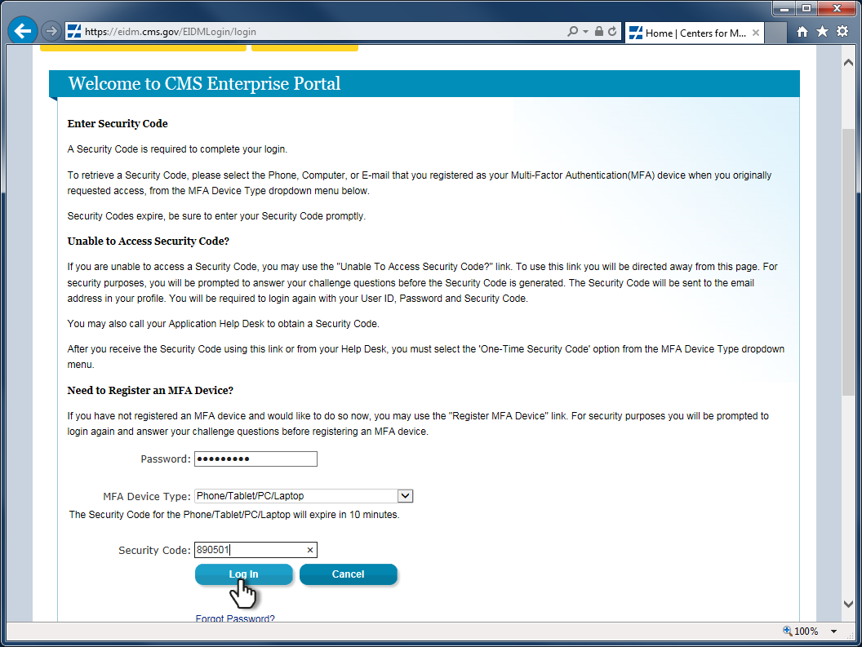
5
Enter your password, select your MFA device method, then enter the security code and click Log In.

Slide 6
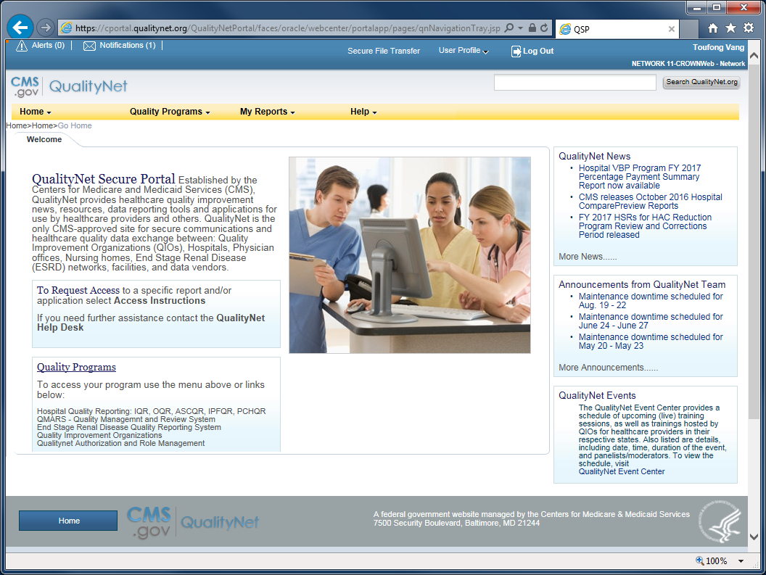
6
The QualityNet Secure Portal home page loads upon your successful sign-in.

Slide 7
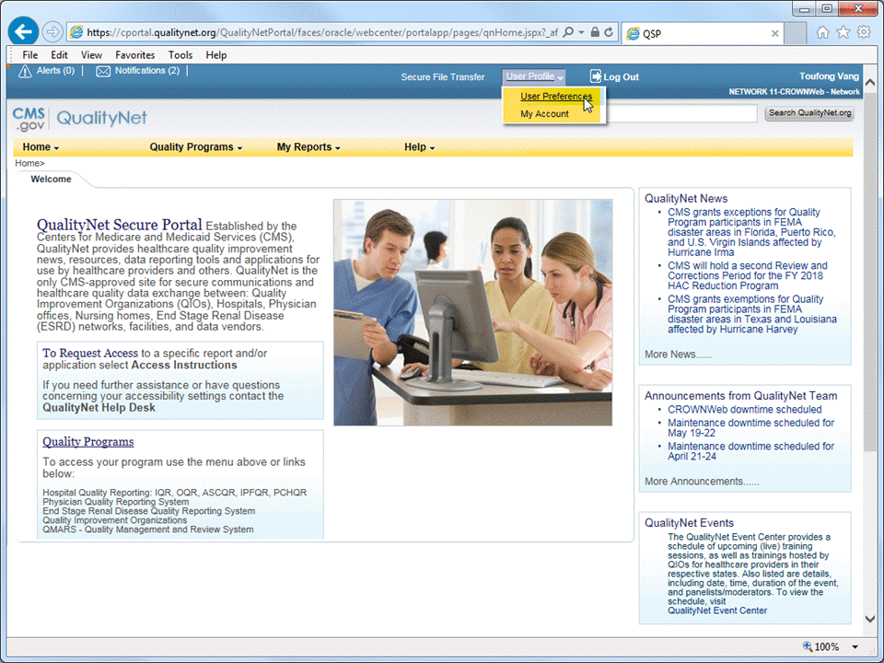
7
Click on User Profile and select
User Preferences from the drop-list.

Slide 8
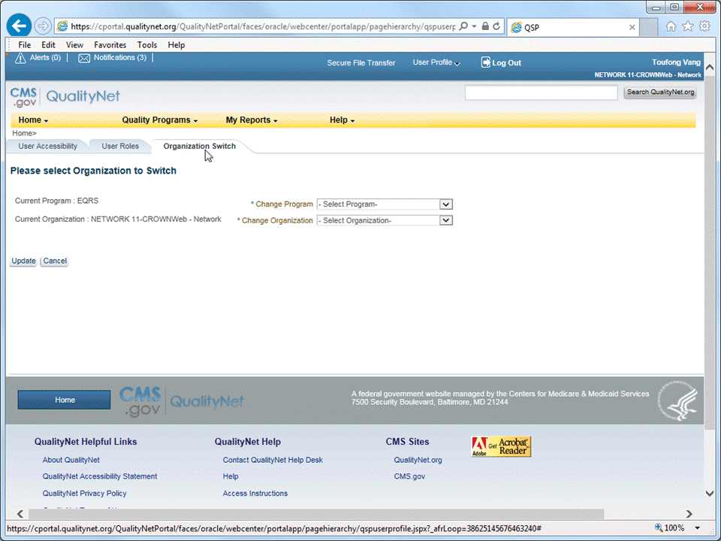
8
Click the Organization Switch tab.

Slide 9
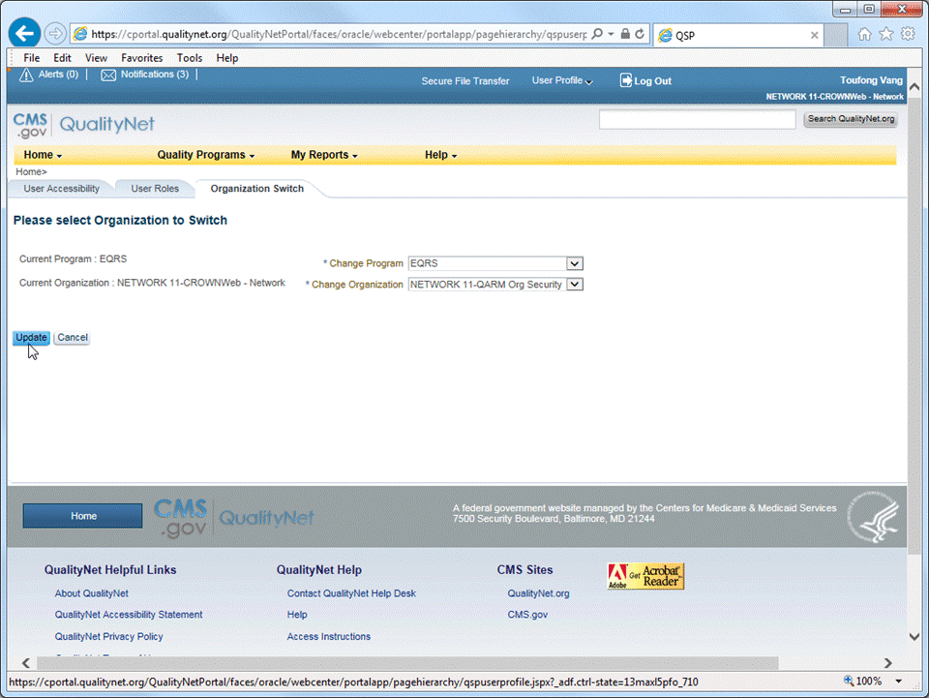
9
• Select EQRS in *Change Program. • Select your QARM Org Security profile in *Change Organization.
• Click Update to apply the profile setting.

Slide 10
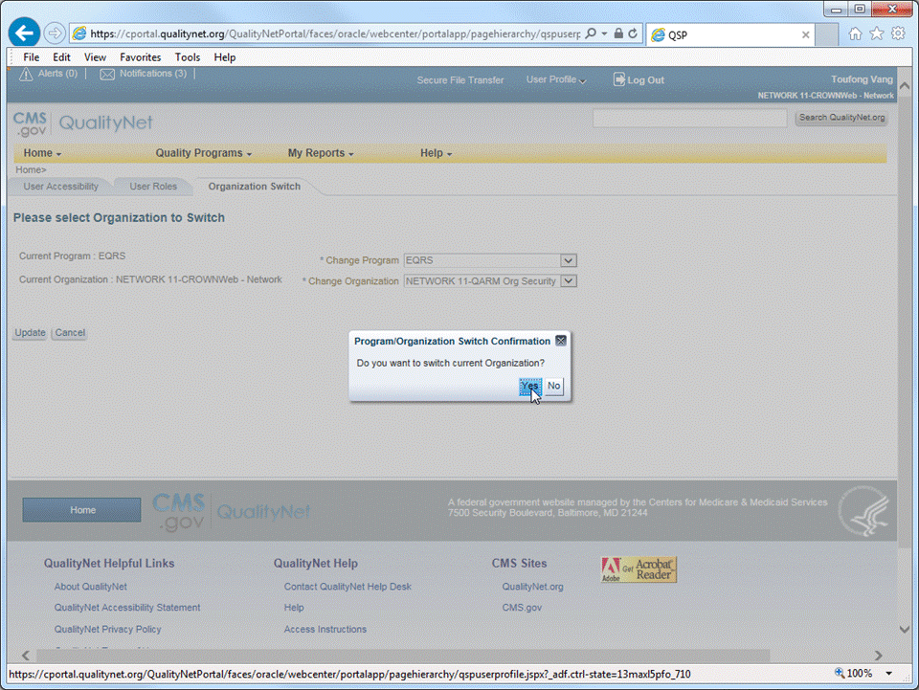
10
Click Yes to proceed.

Slide 11
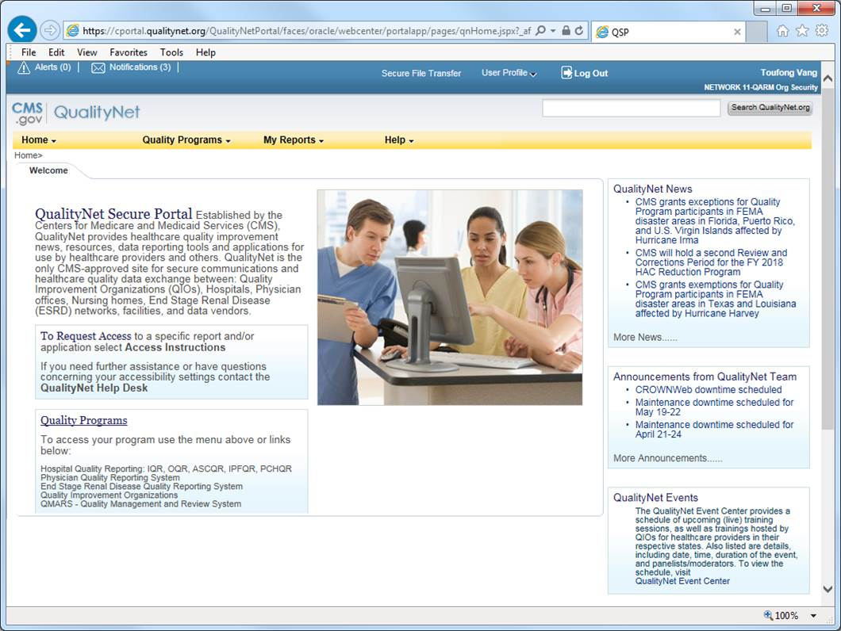
11
Confirm that the correct QARM organization security profile is loaded.

Slide 12
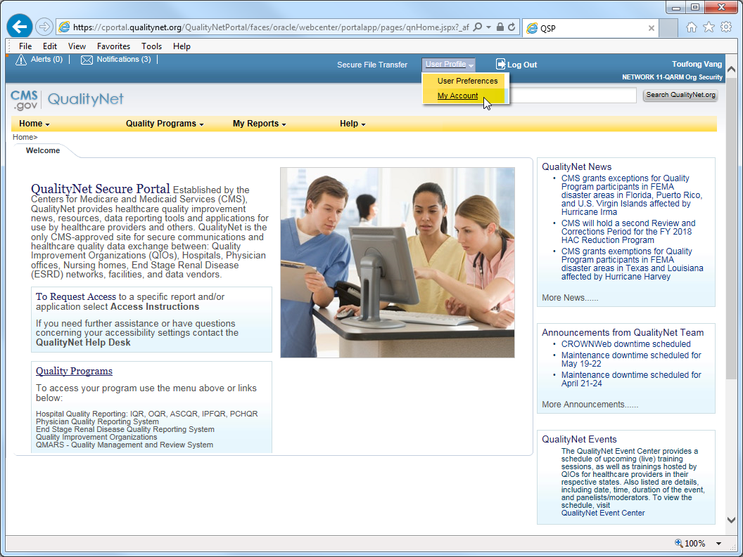
12
Click User Profile and then select My Account.

Slide 13
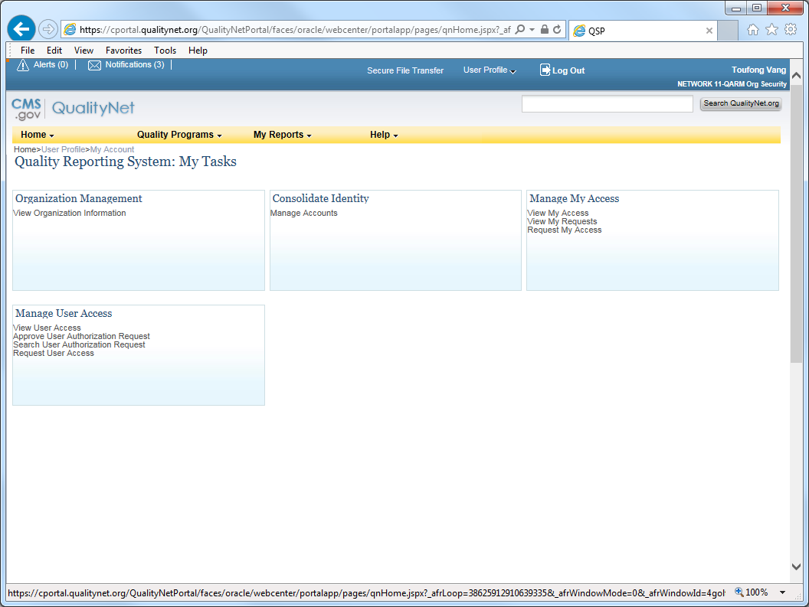
13
The account management tasks page.

Slide 14
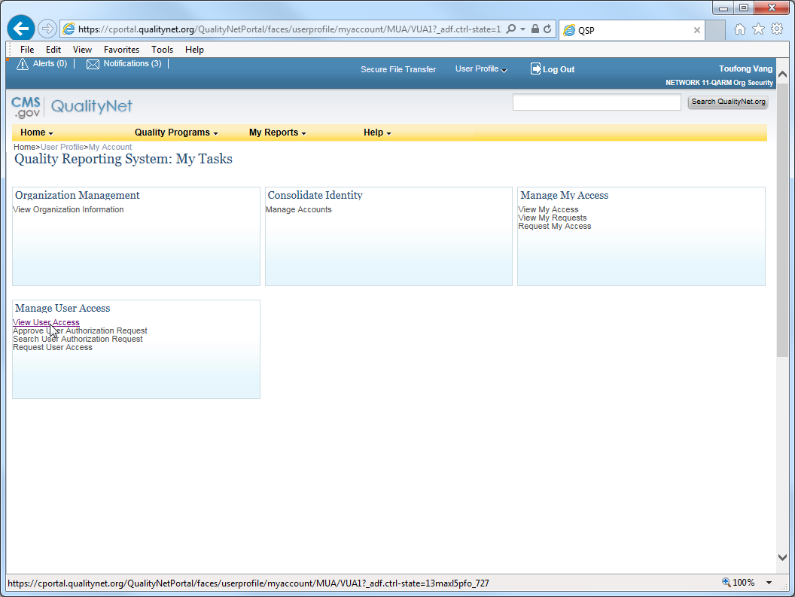
14
Click View User Access.

Slide 15
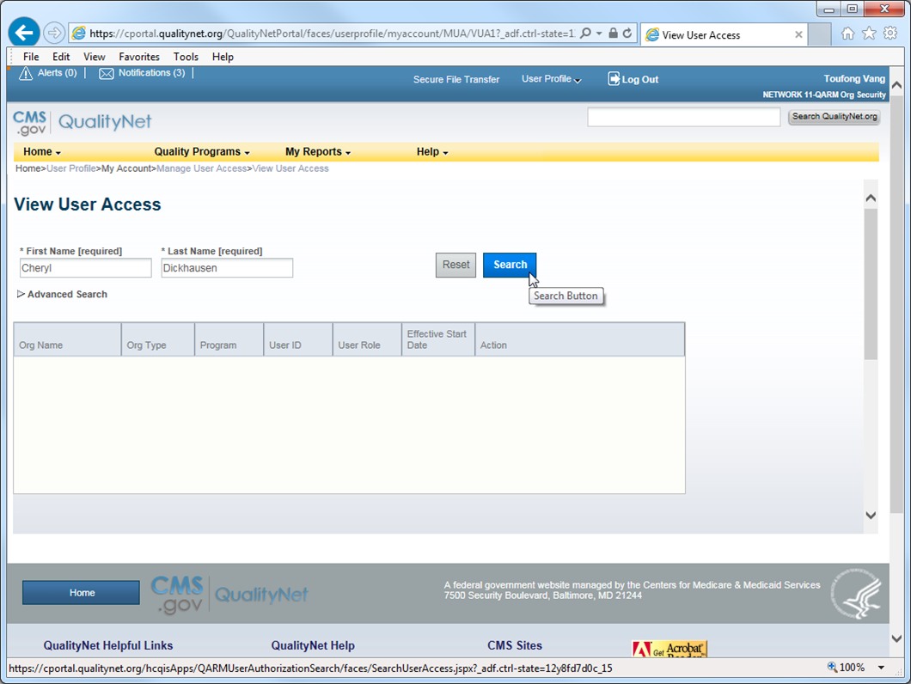
15
Enter the user’s first and last names, and then click Search.

Slide 16
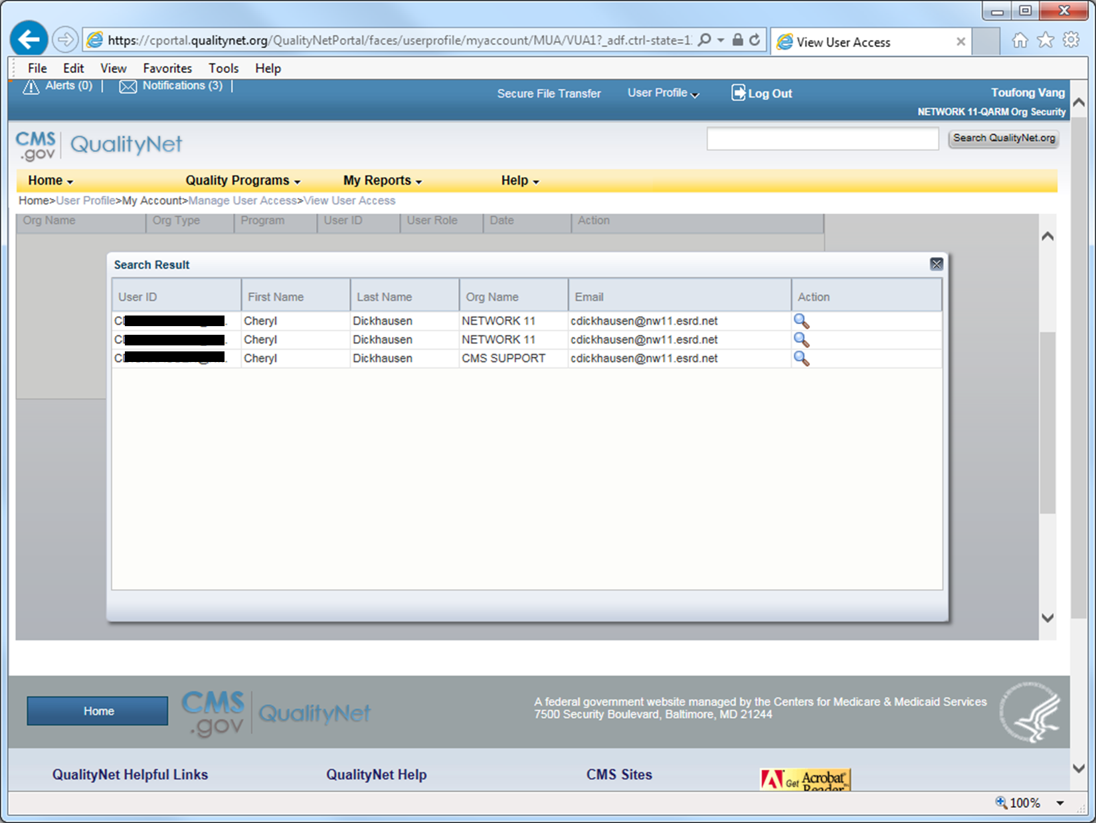
16
Search results.

Slide 17
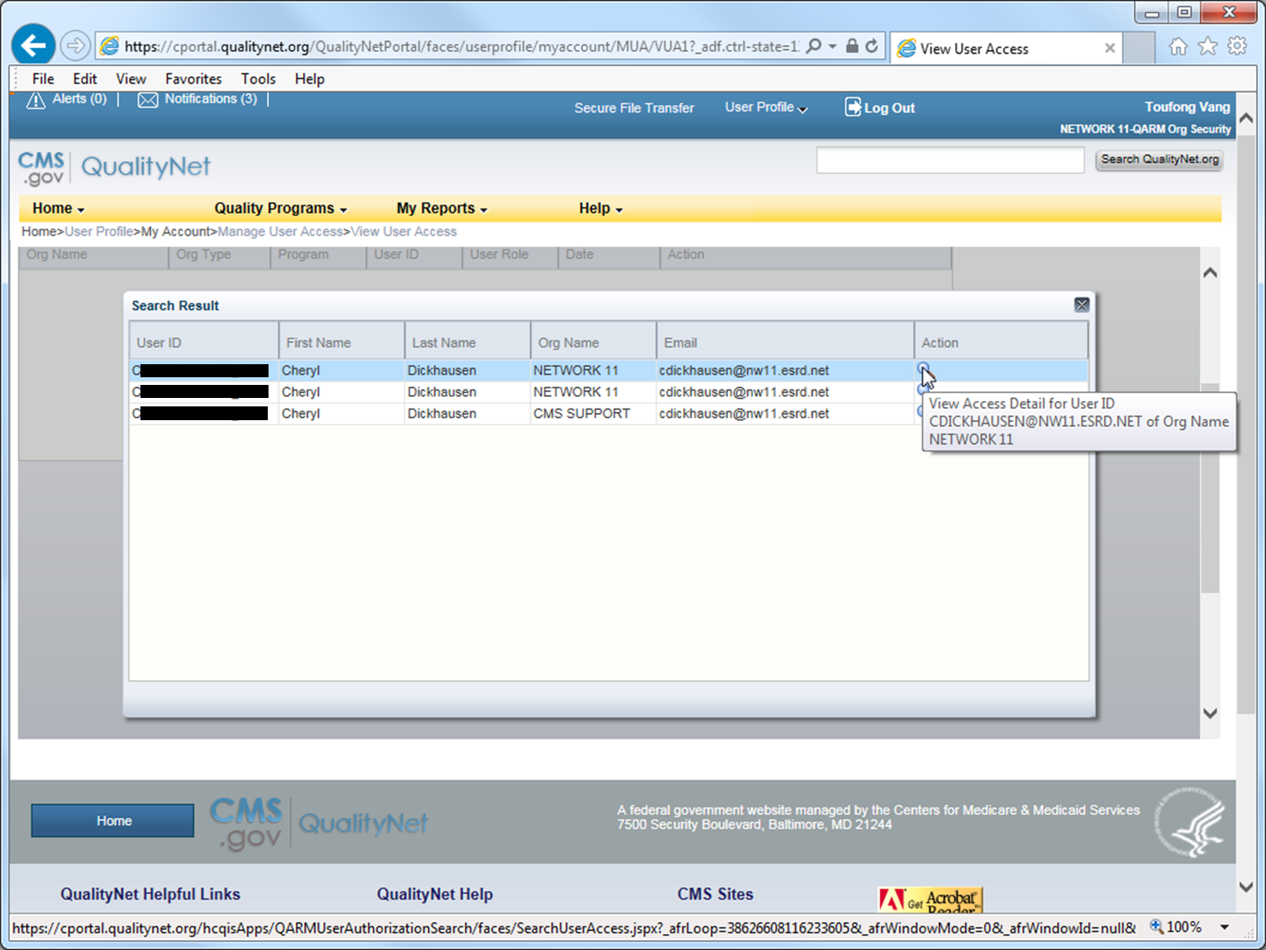
17
In the row (QARM Organization) for which you will be managing the user’s access/role, click on the magnifying glass to display the user’s role.

Slide 18
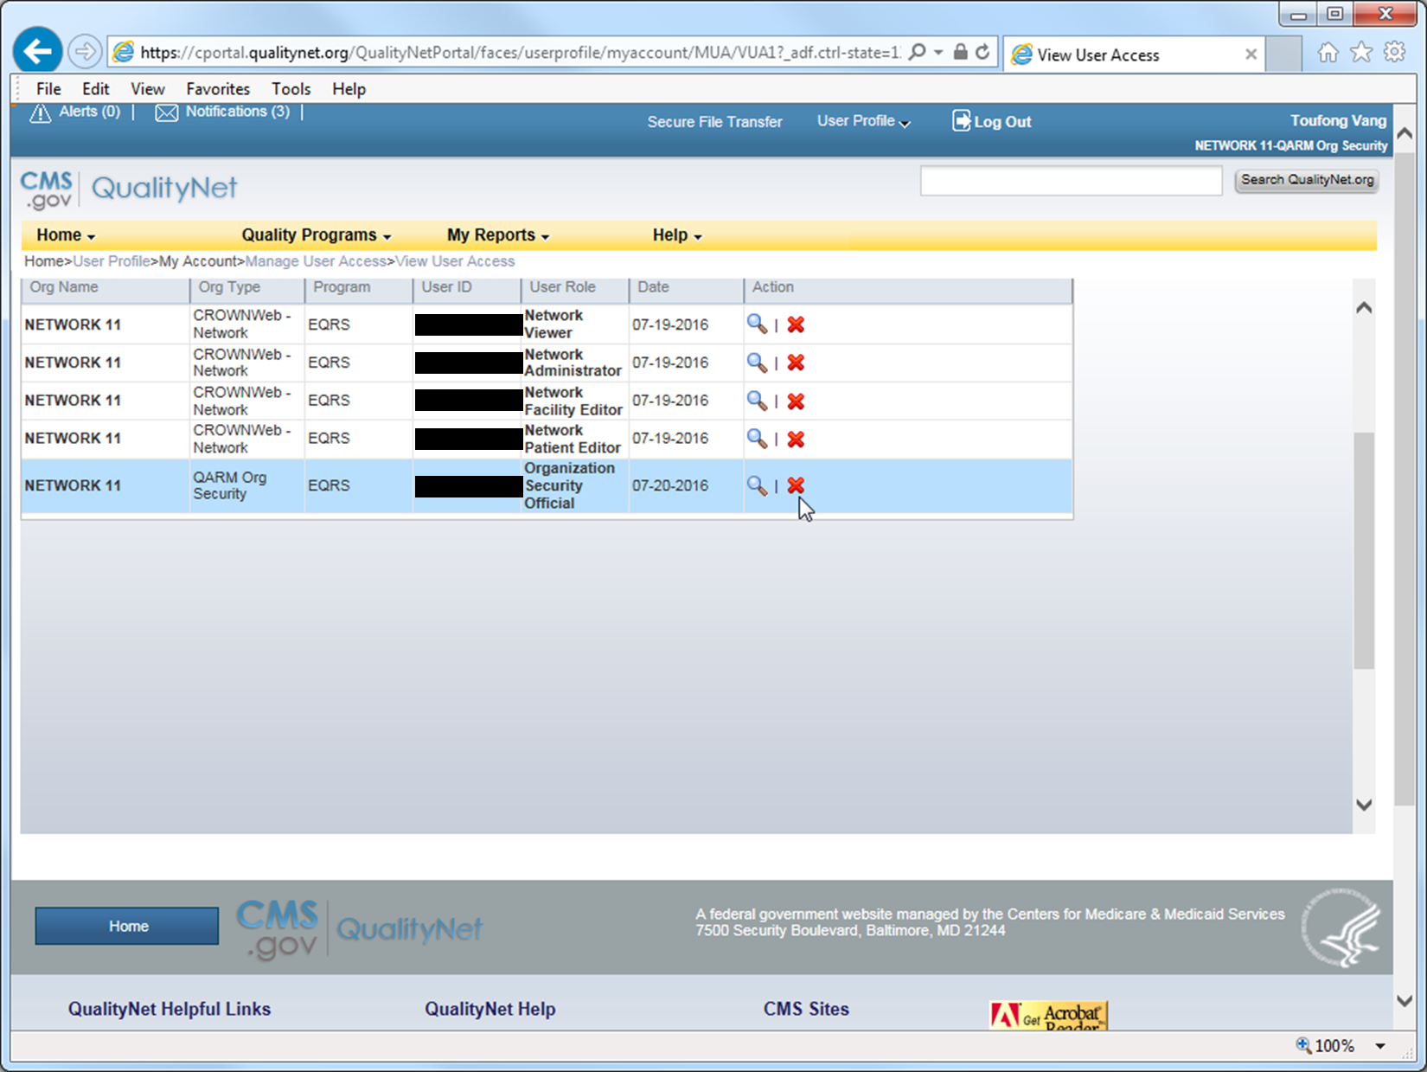
18
Click on the red X to remove the role for that user.

Slide 19
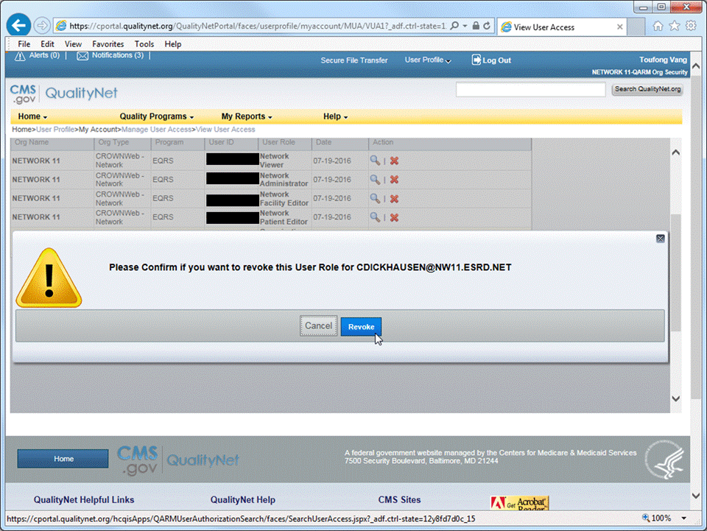
19
Click on the red X to remove the role for that user.

Slide 20
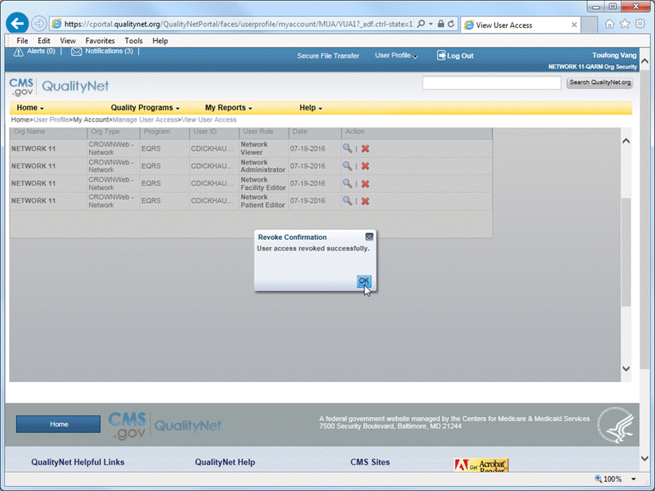
20
Click OK.

Slide 21
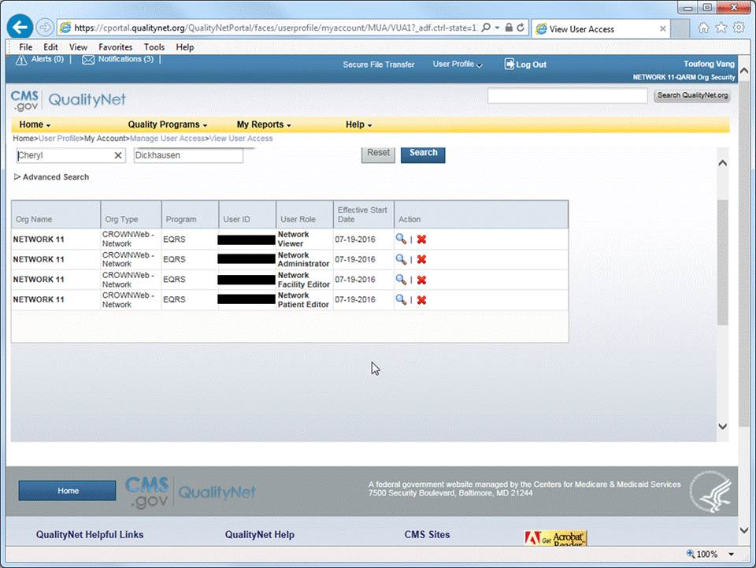
21
Review the user’s remaining access and make changes as needed.

Slide 22
22
Done!

