Slide 1
1
The following slides are screenshots of the process of approving access requests in QARM.

Slide 2
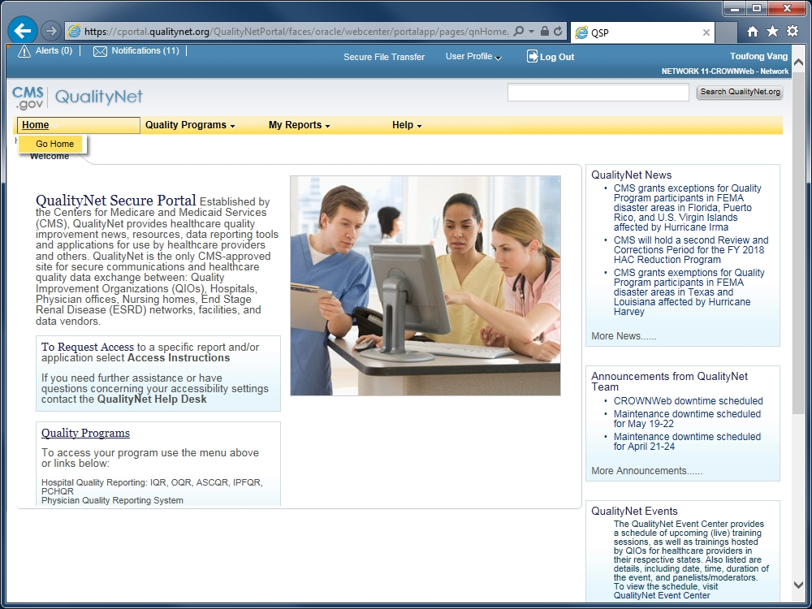
2
From the QualityNet Secure Portal home page...

Slide 3
3
Go to Slide #8 if the Organization + Organization Type listed indicates <Facility_Name> - QARM Org Security. (In this example it does not.)

Slide 4
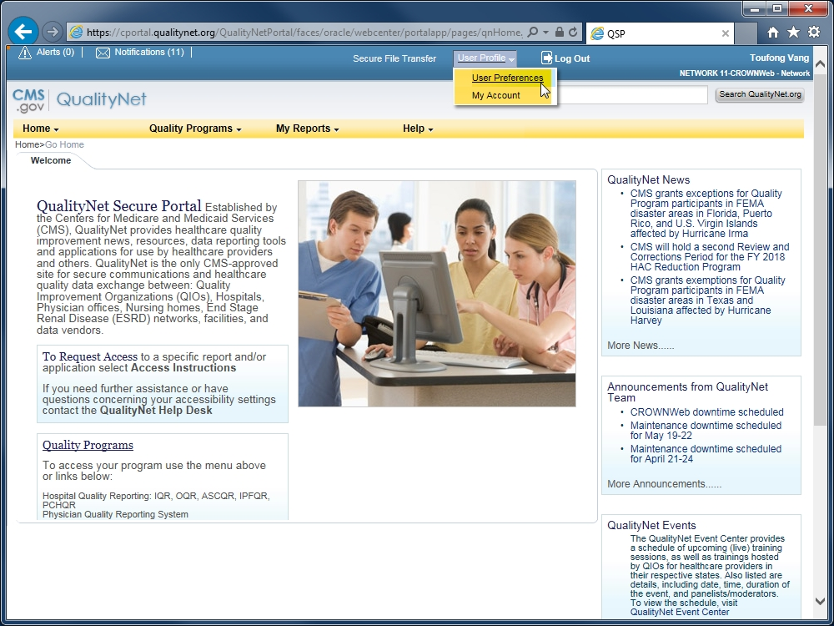
4
To switch...click on User Profile then select User Preferences.

Slide 5
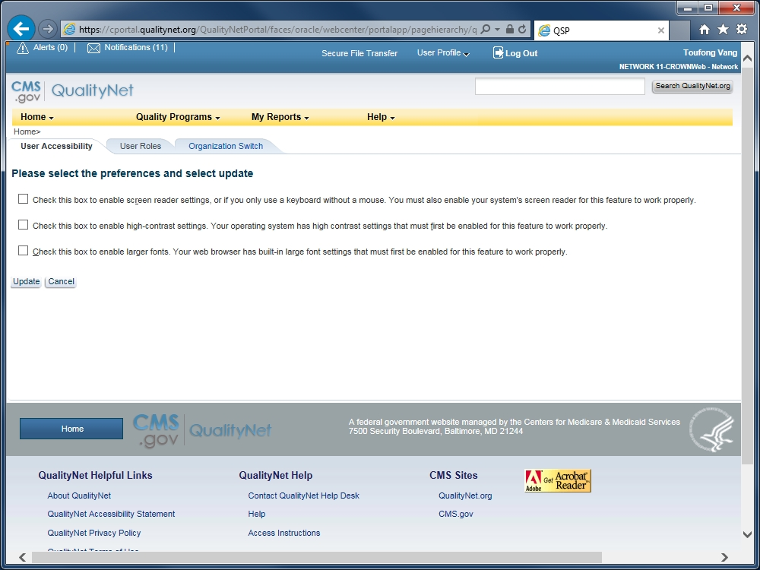
5
Click on the Organization Switch tab.

Slide 6
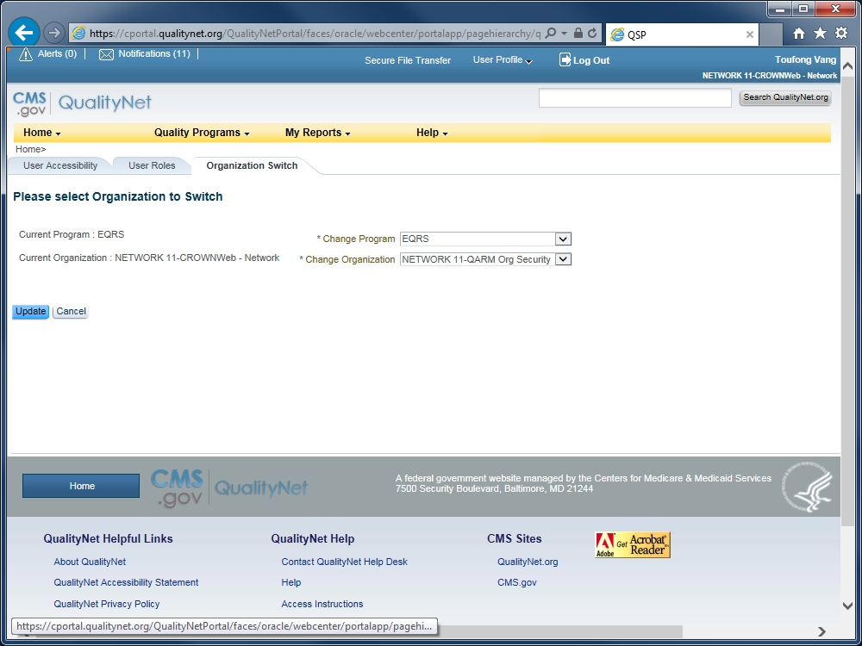
6
This part of the QARM organization name will be different for each facility.
Select EQRS in the field, Change Program.
Select the facility’s QARM Org Security option in the field, Change Organization.
Click Update .

Slide 7
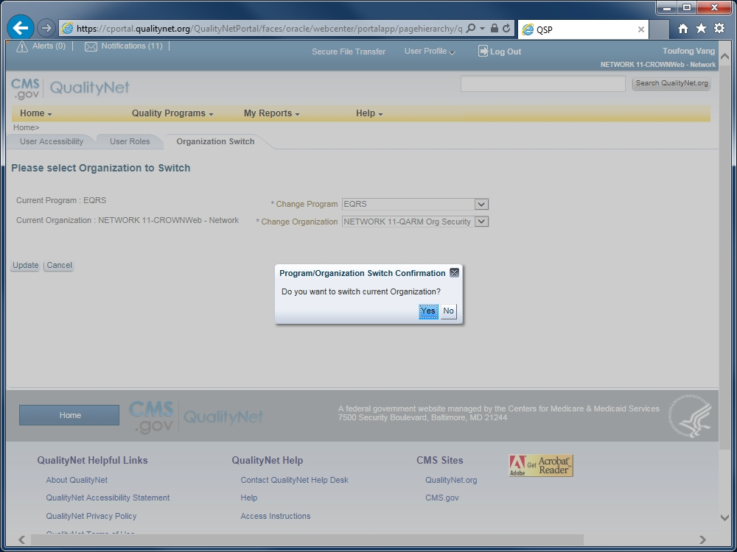
7
Click Yes to confirm the change.
(The QualityNet Secure Portal page will reload.)

Slide 8
8
Confirm that you have the correct Organization Name (your facility) and
Org Type (QARM Org Security) loaded.

Slide 9
9
Click User Profile and select My Account from the drop-list.

Slide 10
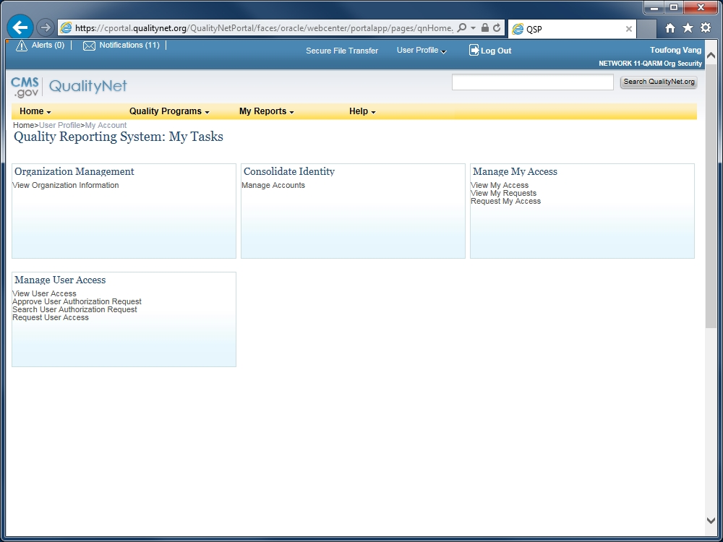
10
The My Tasks page for managing accounts loads.

Slide 11
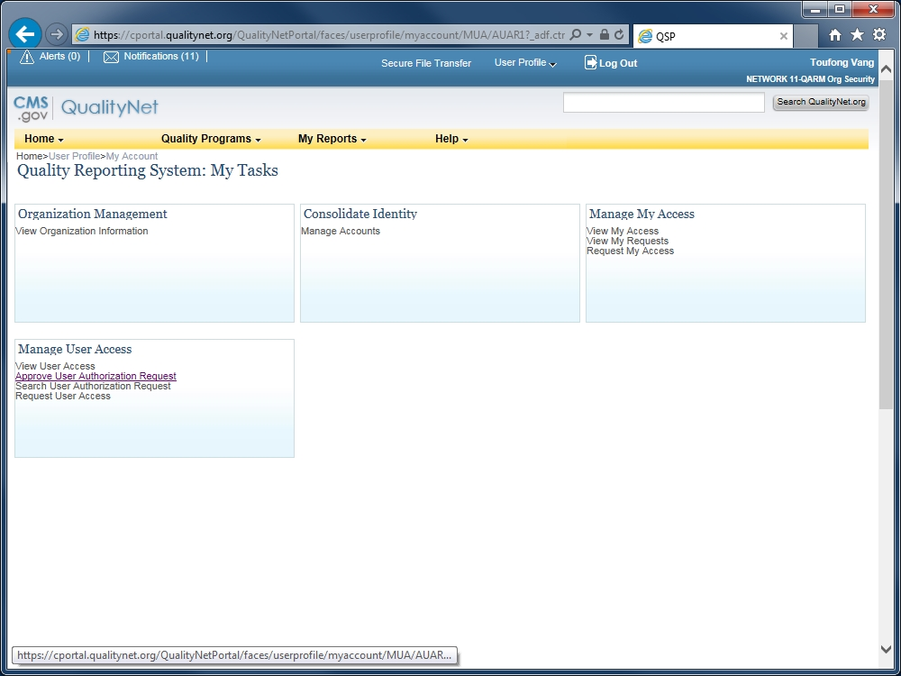
11
Click Approve User Authorization Request.

Slide 12
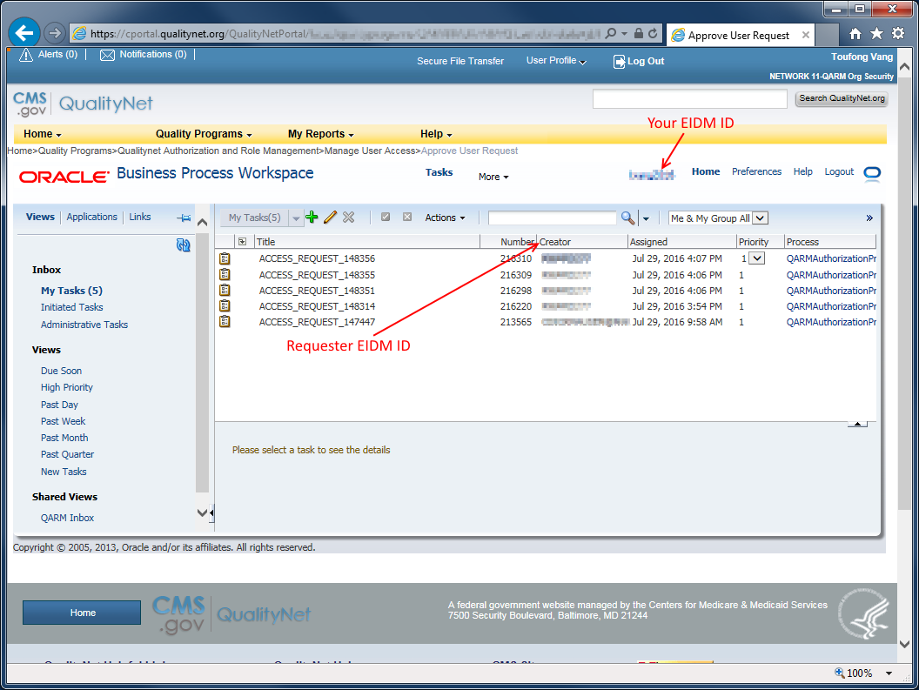
12
List of unprocessed requests

Slide 13
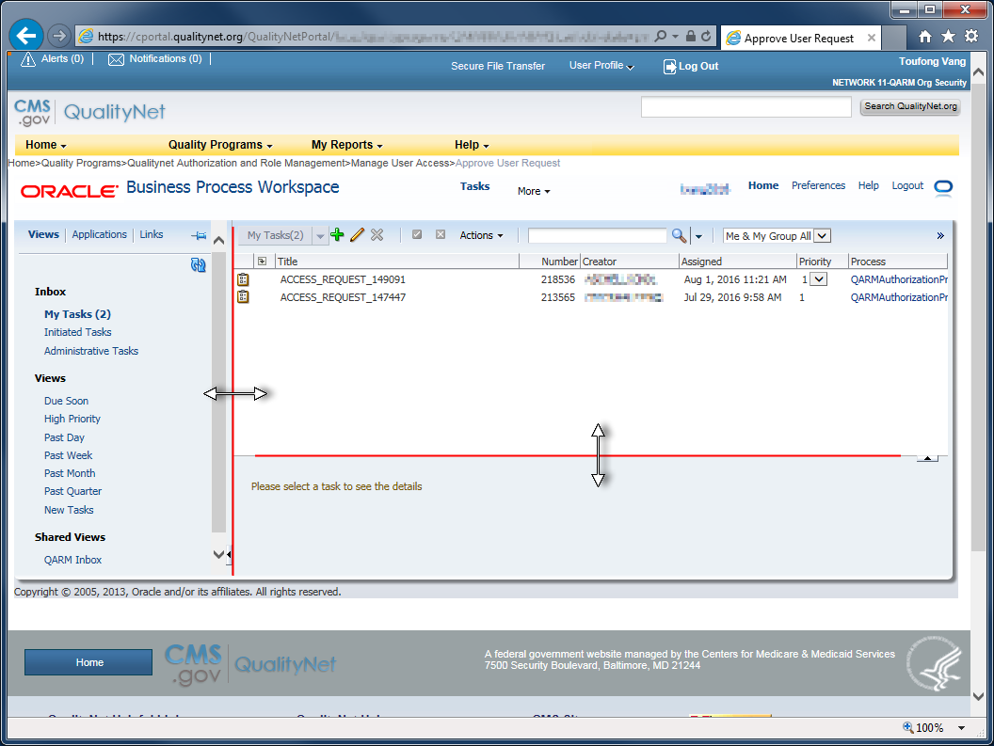
13
TIP: To resize the frames, hover the mouse over an edge of the frame until the icon changes, then left-click and drag the edge while holding down the mouse button.

Slide 14
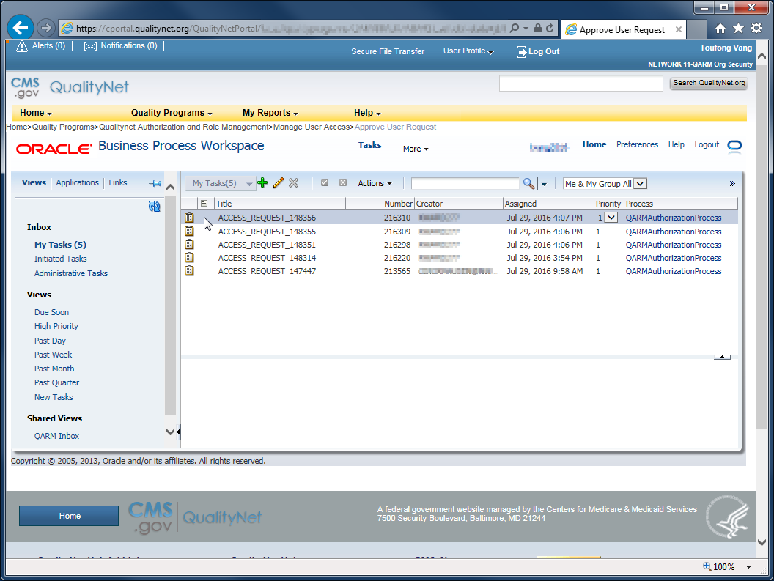
14
There are two methods of loading a request to work on:
Left-click once to load the item in the bottom frame.
Double left-click to open the item in a new, pop-up window.

Slide 15
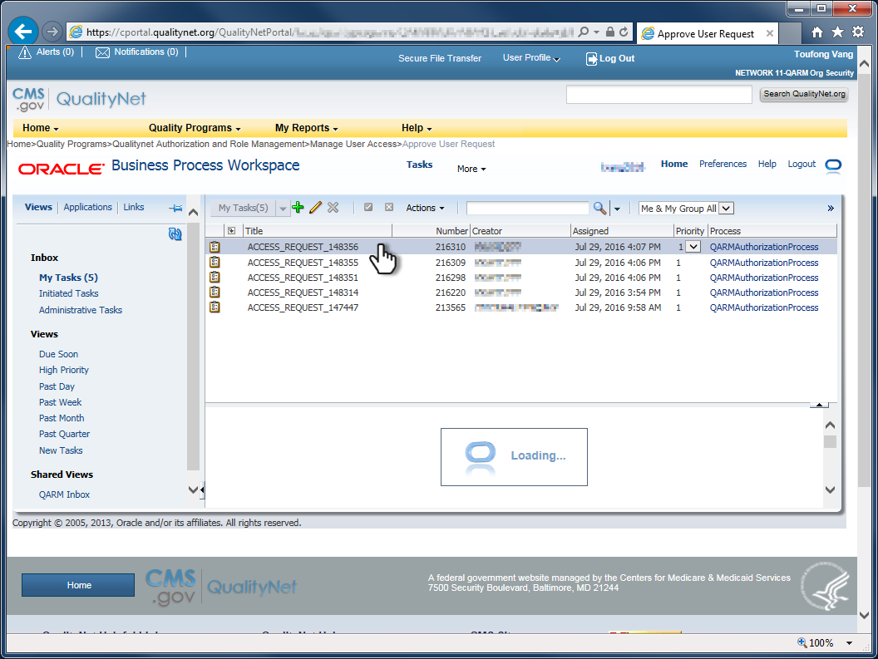
15
In this example, the request item will load in the lower frame for processing.

Slide 16
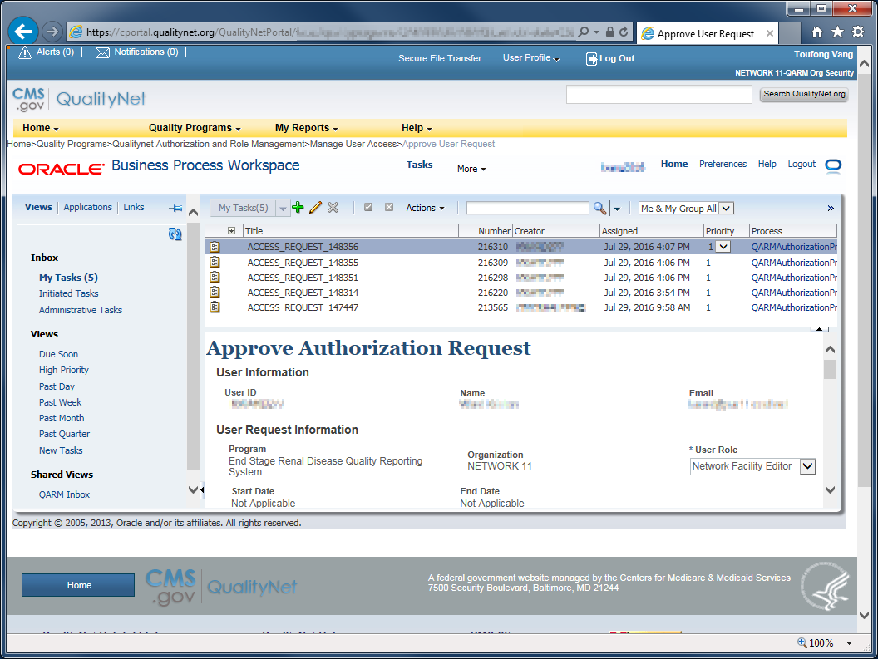
16
Request item loaded and lower frame resized.

Slide 17
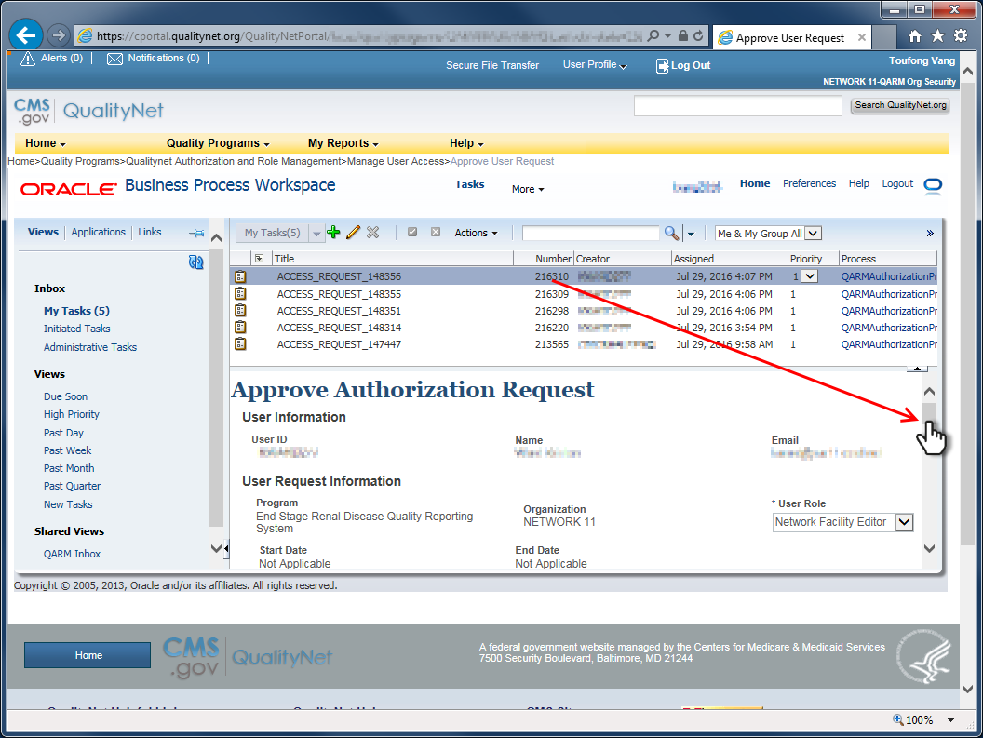
17
Use the inner scroll bar to scroll down the frame in order to review details of the access request.

Slide 18
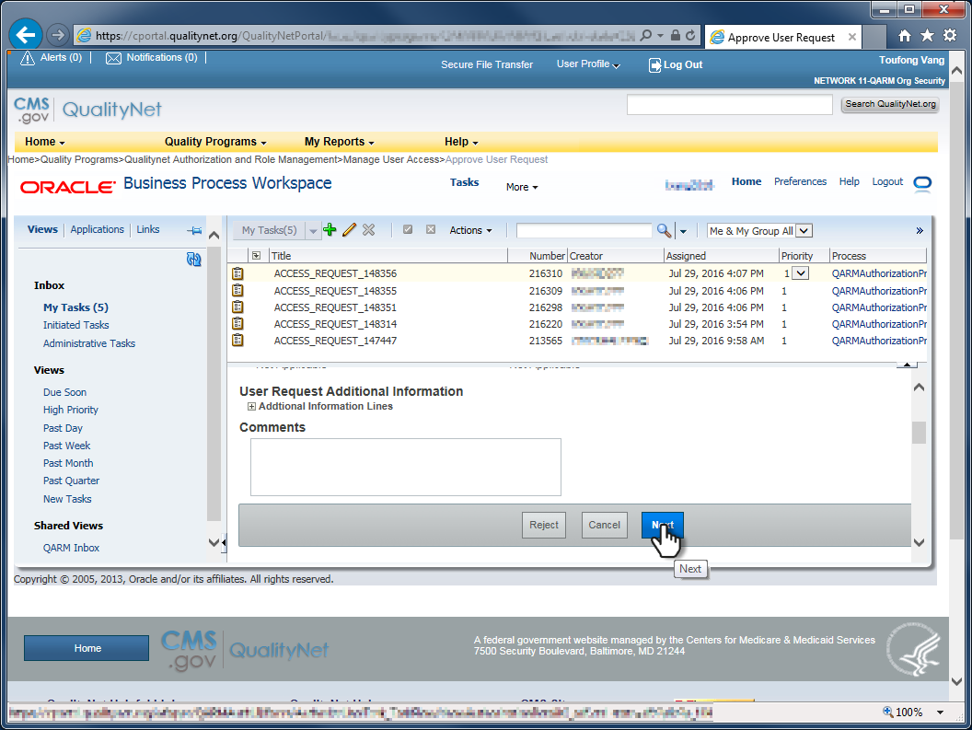
18
Click Next when done reviewing, and to load the next page of details.

Slide 19
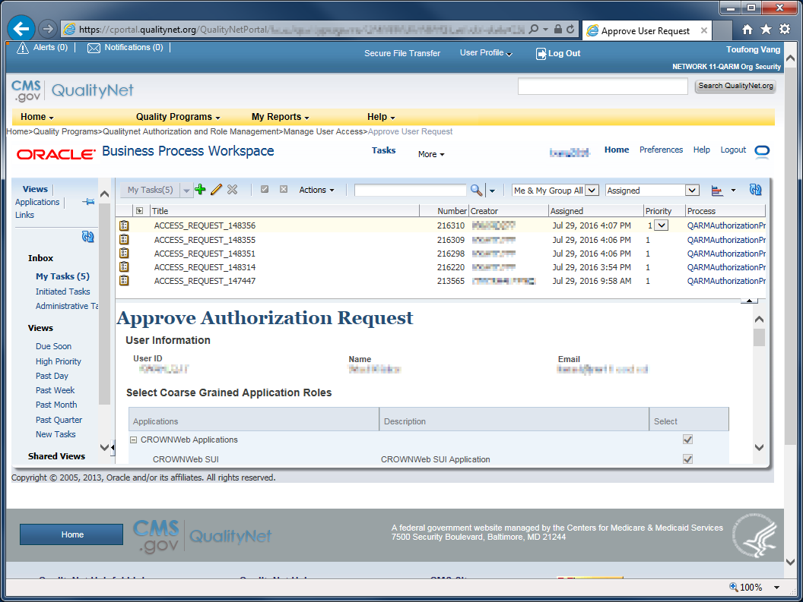
19
The Coarse Grained Application Roles details load. Scroll down to review and click Next to load the Fine Grained Application Roles details.

Slide 20
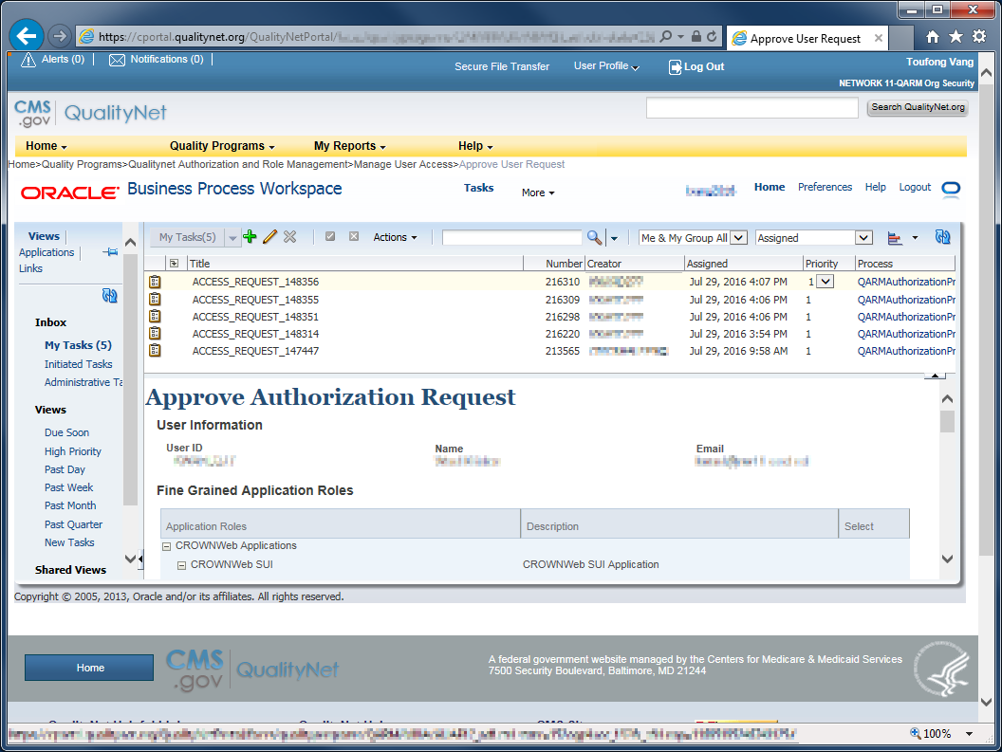
20
Scroll to review...

Slide 21
21
Click Next to proceed...

Slide 22
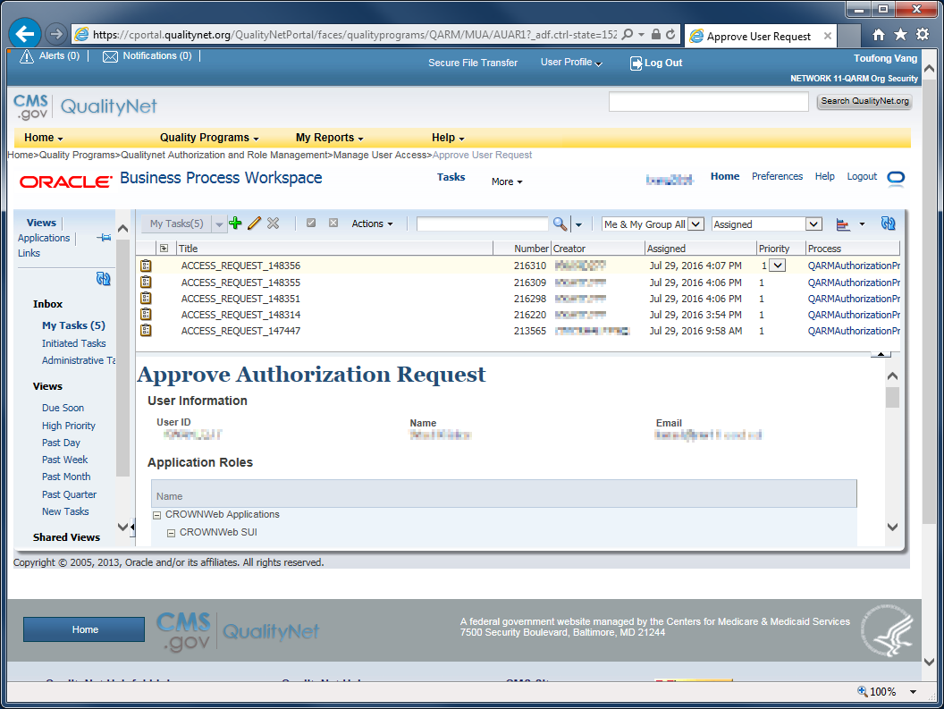
22
Review the summary...

Slide 23
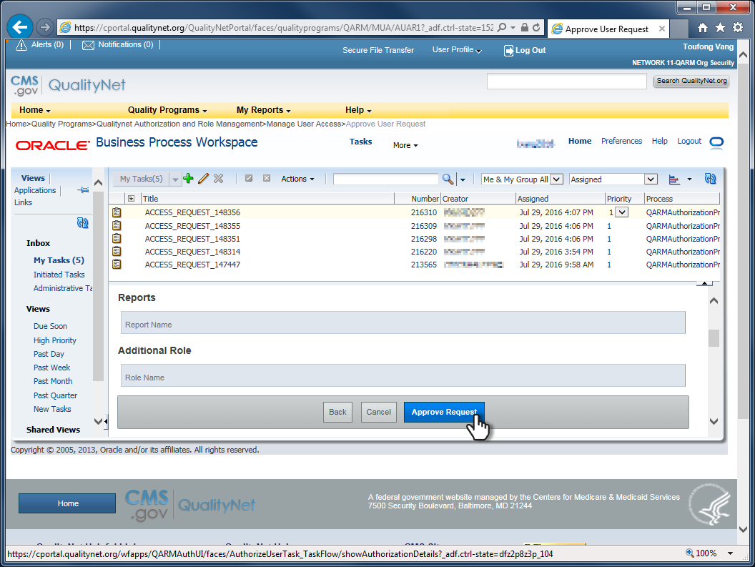
23
Click Approve Request to proceed...

Slide 24
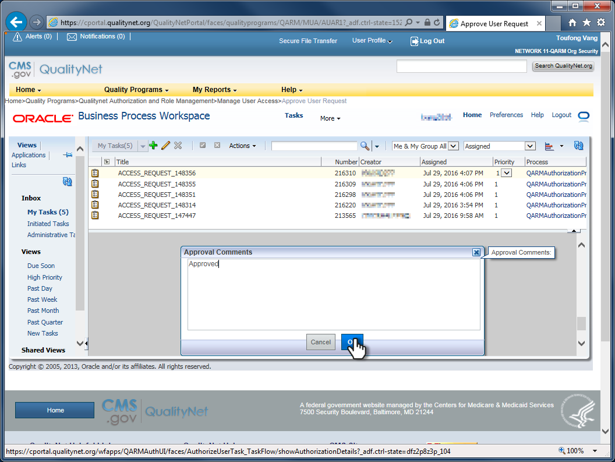
24
Add comments if necessary and click OK.

Slide 25
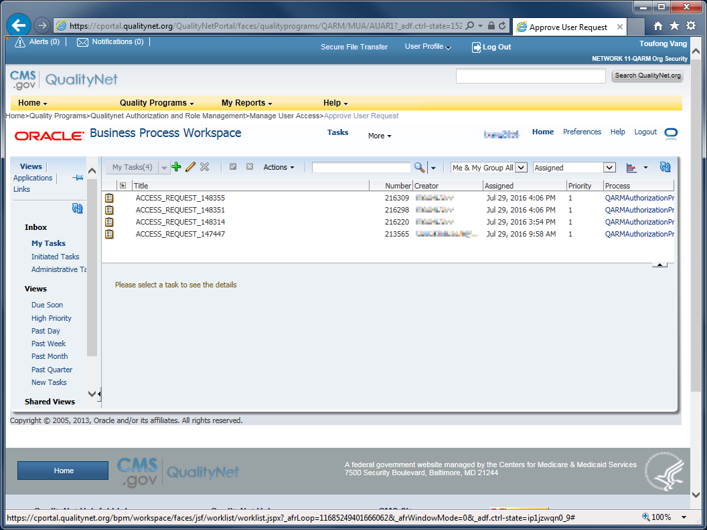
25
The processed request item is removed from list. The requester and the approver will receive a notice from QARM.

Slide 26
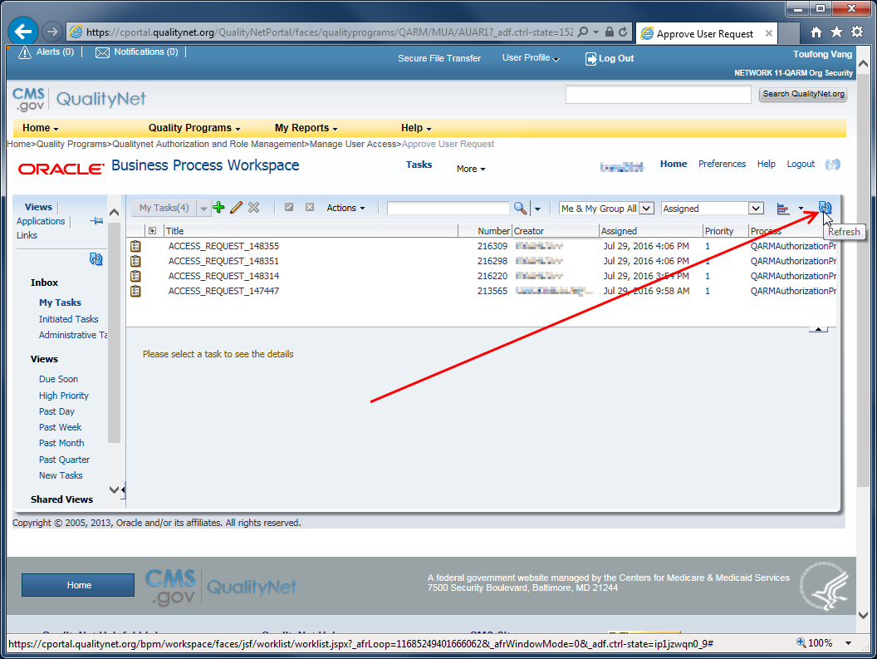
26
Click the refresh icon to reload the request list, if needed.

Slide 27
27
Done!

