Slide 1
1
The following slides are screenshots of the steps for logging-in to the QualityNet Secure Portal.

Slide 2
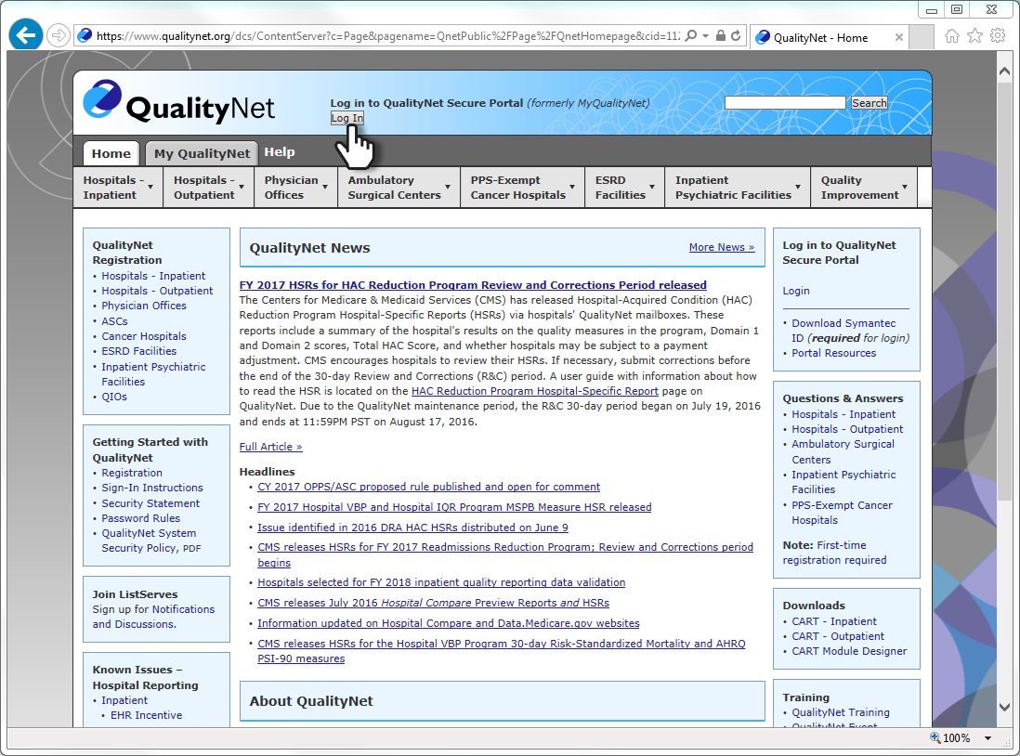
2
Log in at www.qualitynet.org

Slide 3
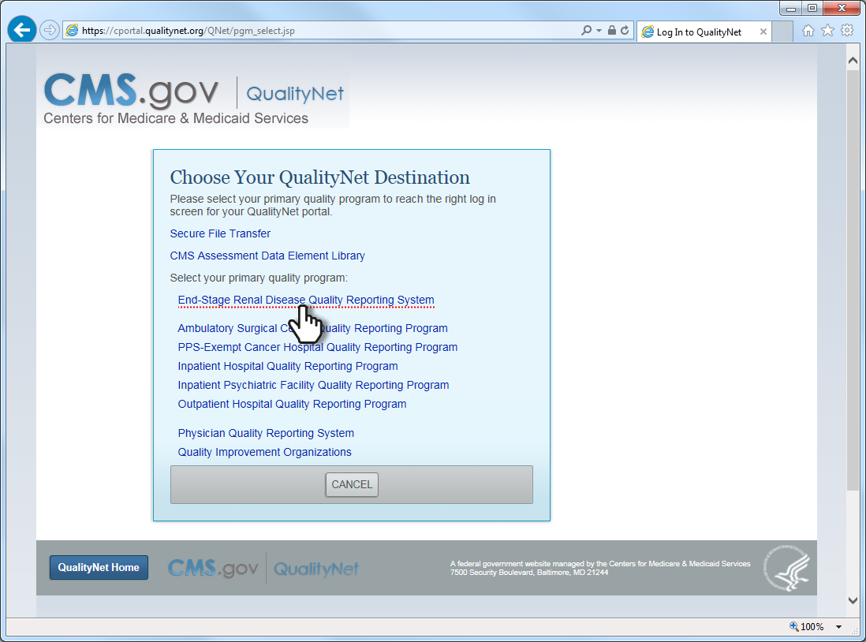
3
Click on the link, “End-Stage Renal Disease Quality Reporting System”

Slide 4
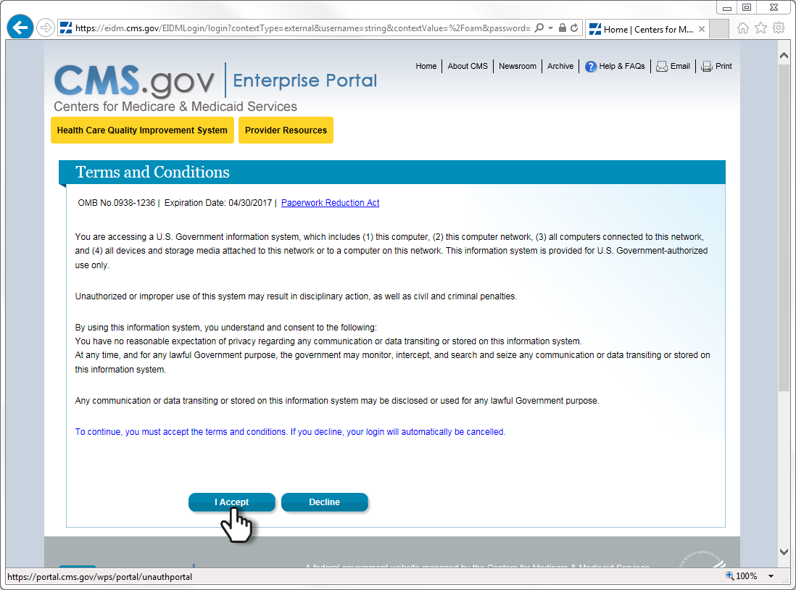
4
Accept the terms and conditions.

Slide 5
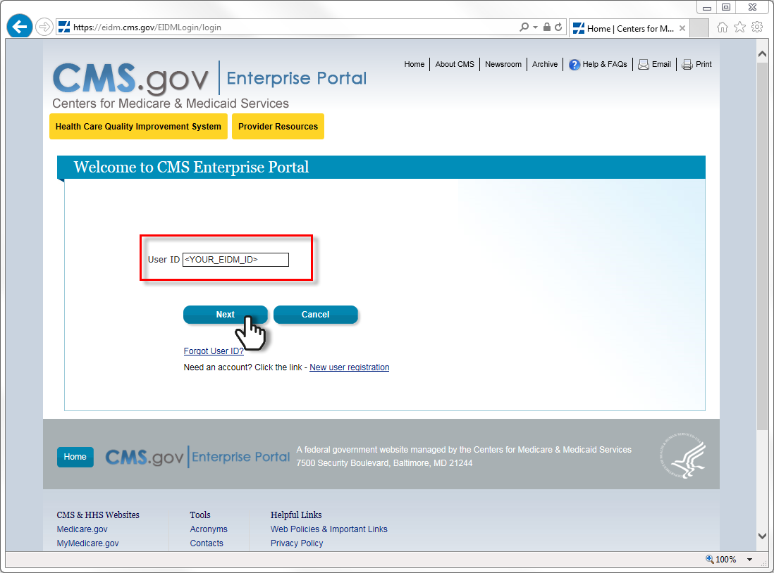
5
Enter your EIDM user ID, and then click “Next”.

Slide 6
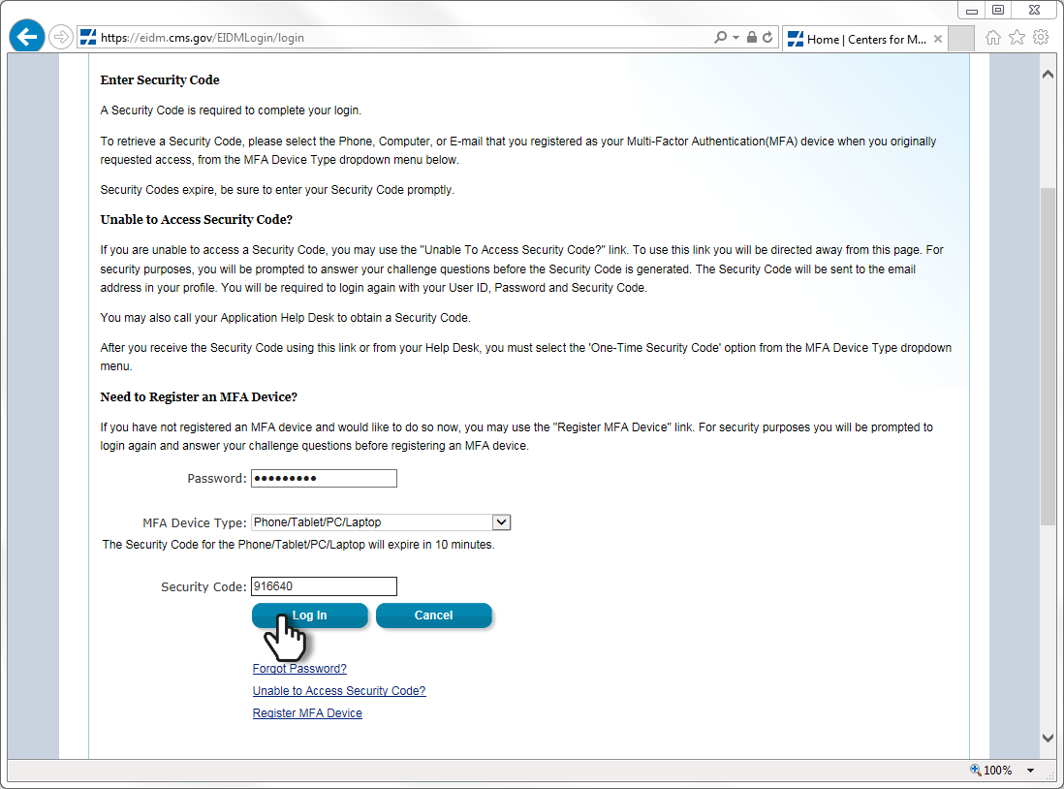
6
Enter your password and TFA code, and then click, “Log In”.

Slide 7
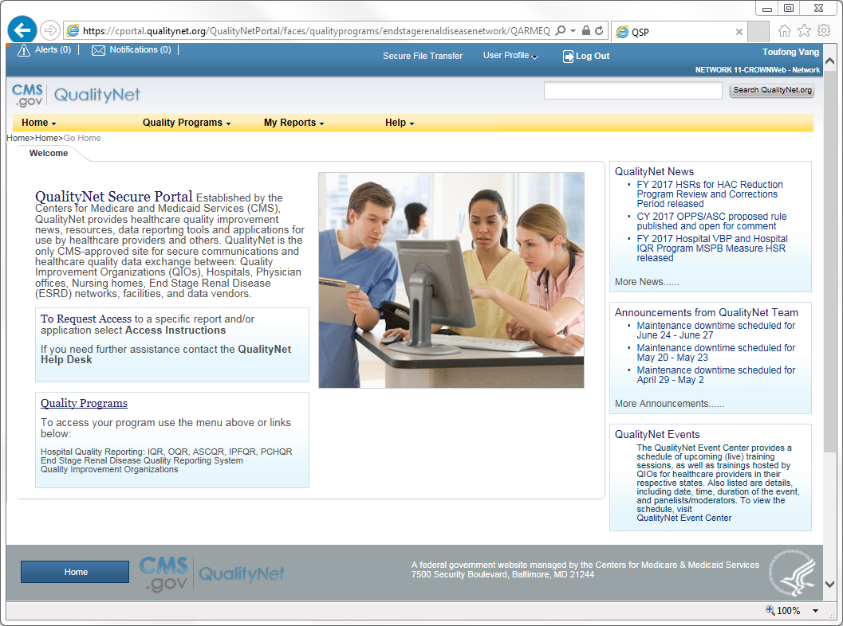
7
The “QualityNet Secure Portal” home page loads upon your successful sign-in.

Slide 8
8
Additional Resources:
EIDM and QARM Quick Start Guide
http://mycrownweb.org/wp-content/uploads/2016/07/EIDM_QARM_Registration_Process_Final_V.pdf
EIDM and QARM Webinar Recording
http://mycrownweb.org/assets/Webex/eidm
EIDM FAQs
https://portal.cms.gov/wps/portal/unauthportal/faq

