Slide 1
1
The following slides are screenshots of the steps for generating and downloading an ESRD QIP PSC.

Slide 2
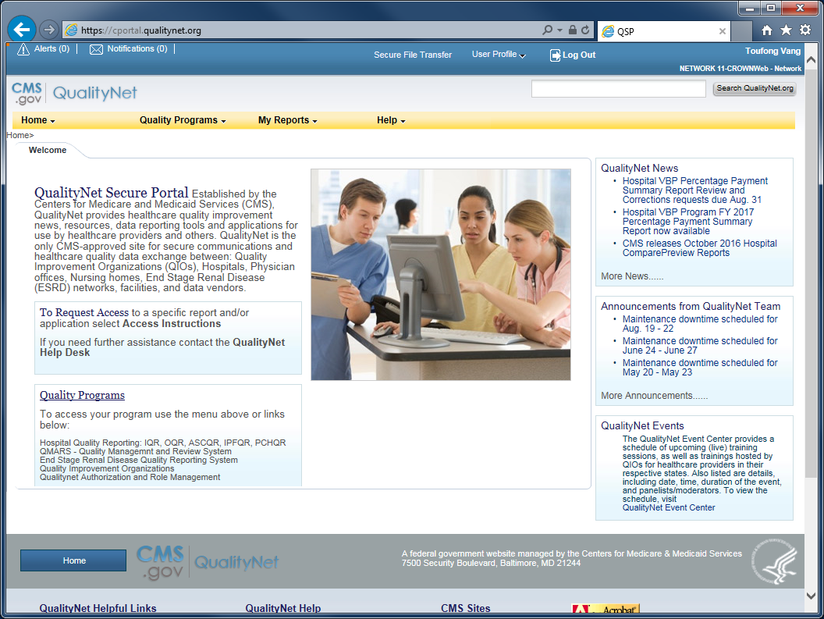
2
Start at the QualityNet Secure Portal (QSP) home page.

Slide 3
3
Ensure that you are connected to QSP with your ESRD QIP profile.
(In this example the user is connected with his CROWNWeb - Network profile. This needs to be switched to his ESRD QIP profile.)

Slide 4
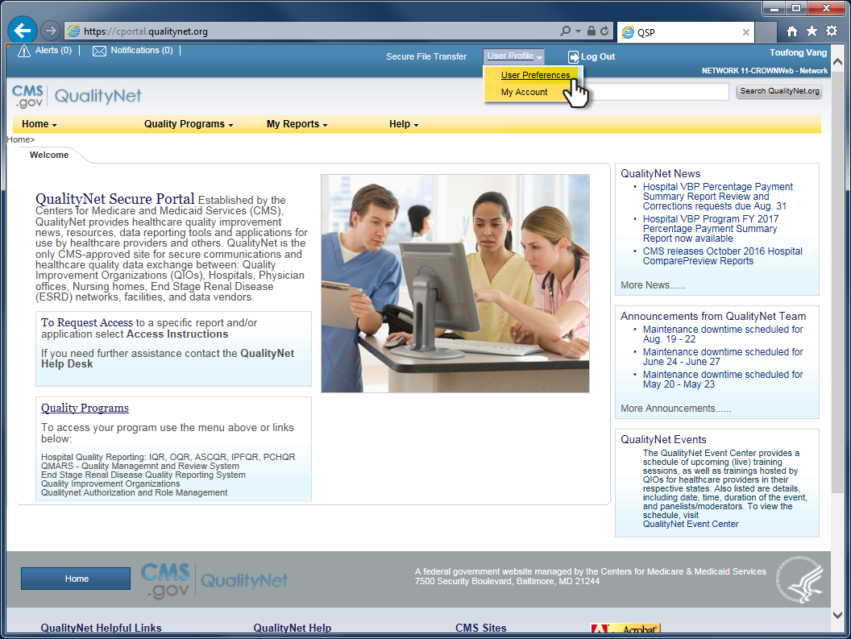
4
To switch profiles...
Click User Profile and select User Preferences.

Slide 5
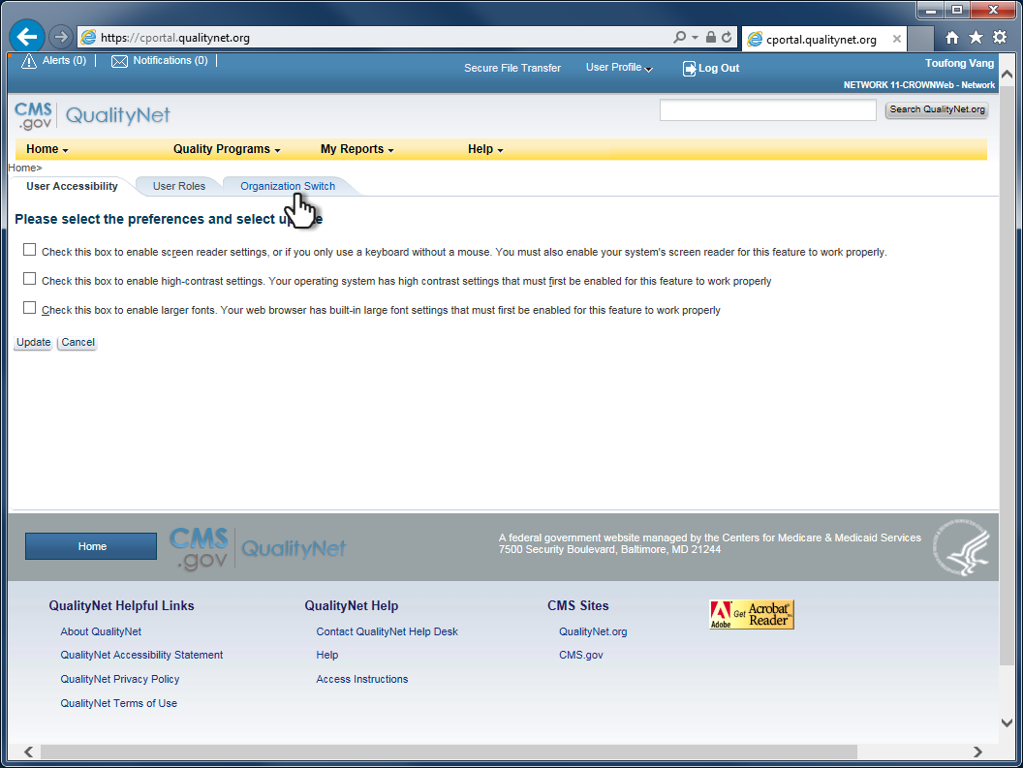
5
Click the Organization Switch tab.

Slide 6
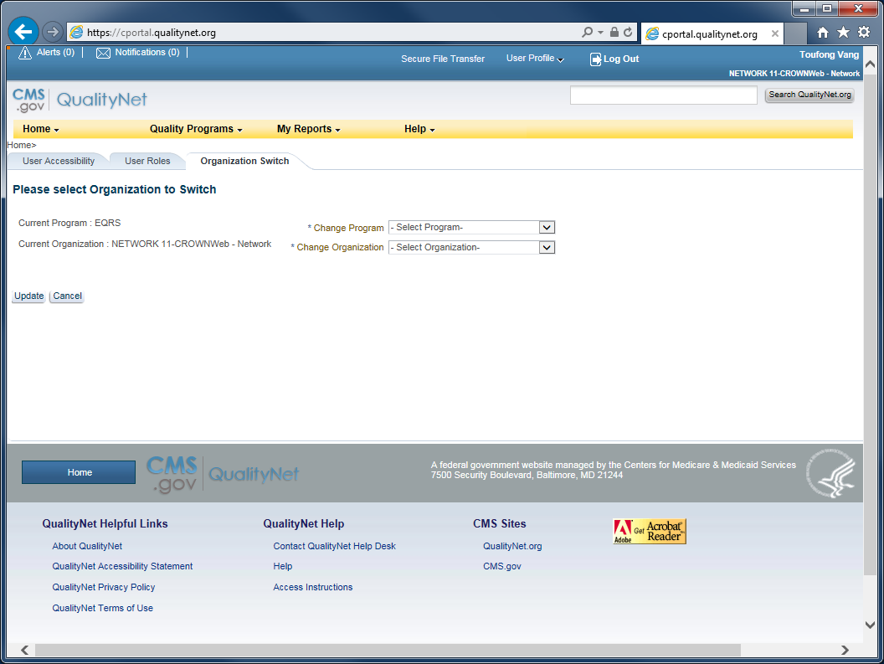
6
The Organization Switch tab...

Slide 7
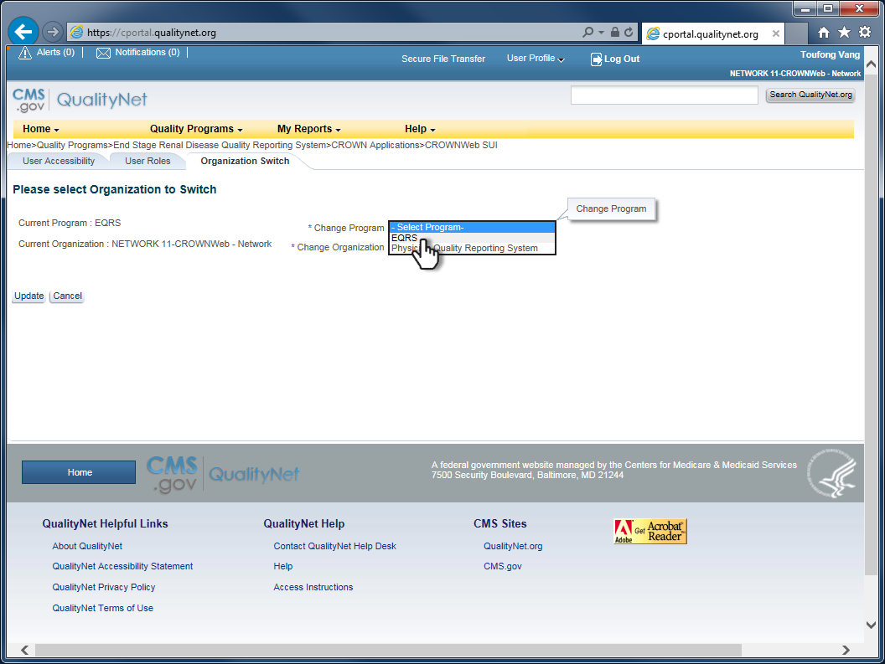
7
Set the Program to EQRS.

Slide 8
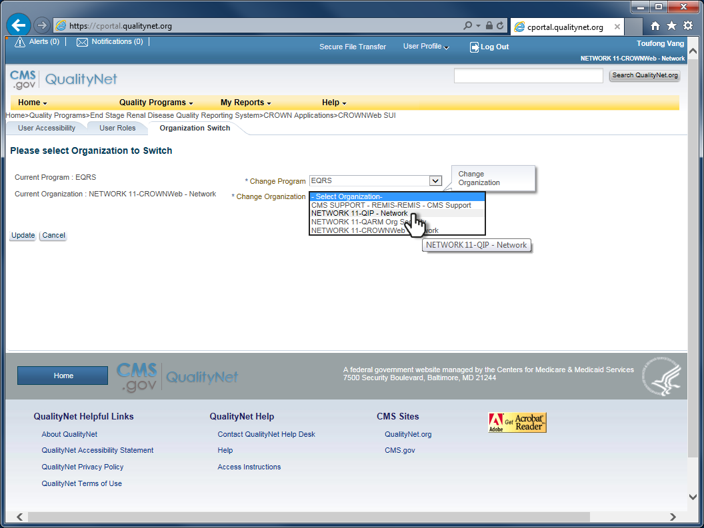
8
Set the “organization” to the QIP profile that is to be loaded for use.

Slide 9
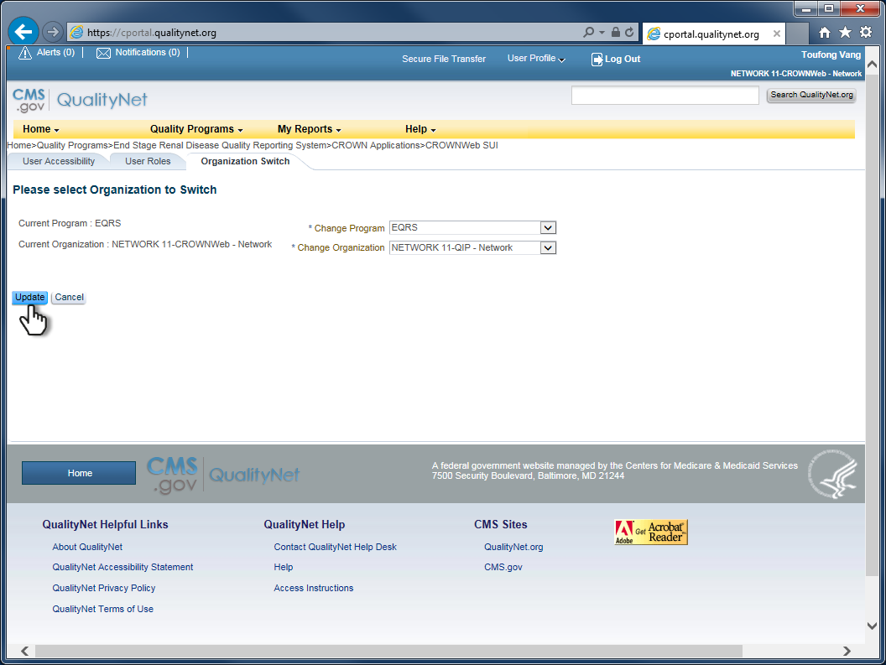
9
Click Update.

Slide 10
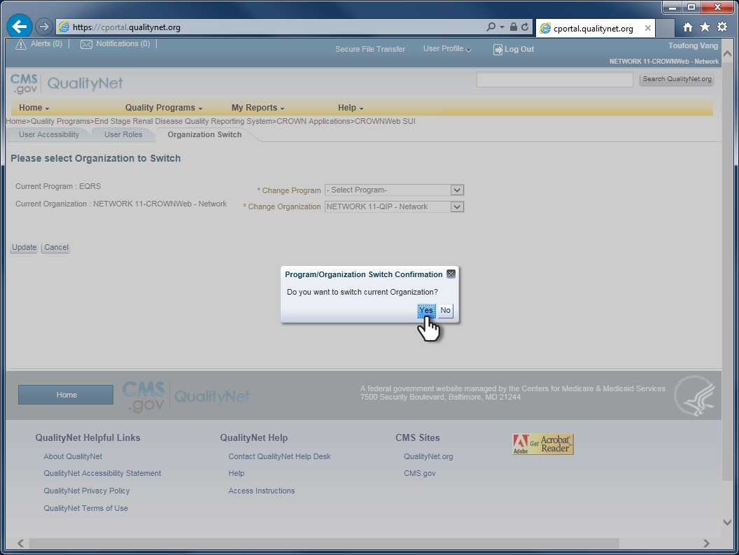
10
Click Yes to confirm the switch.

Slide 11
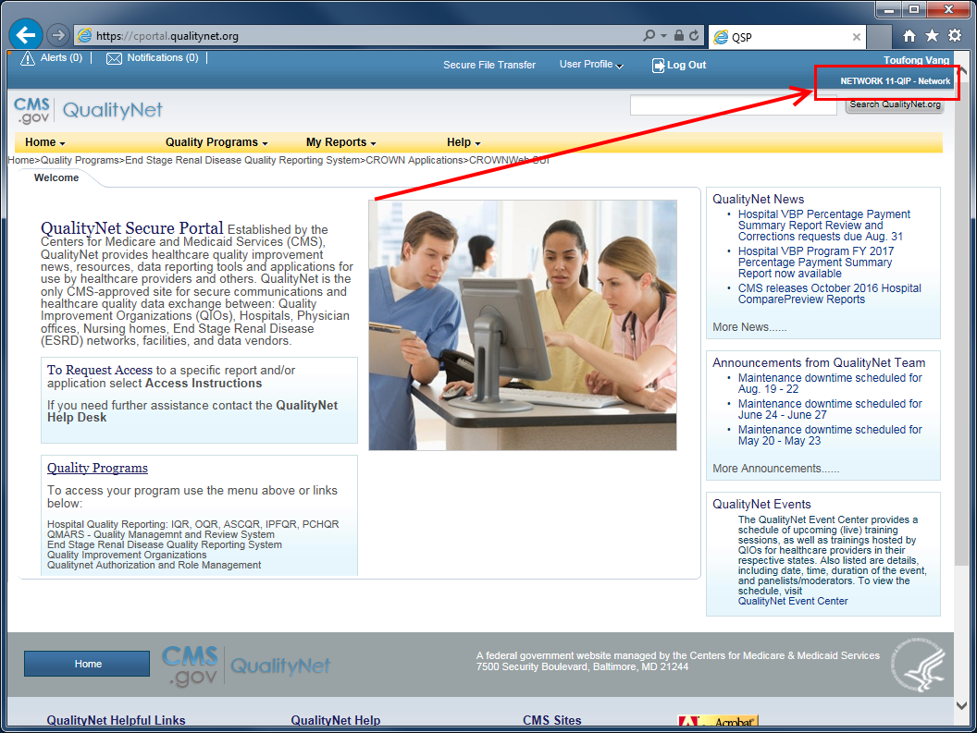
11
Verify that the switch to your ESRD QIP profile was successful.

Slide 12
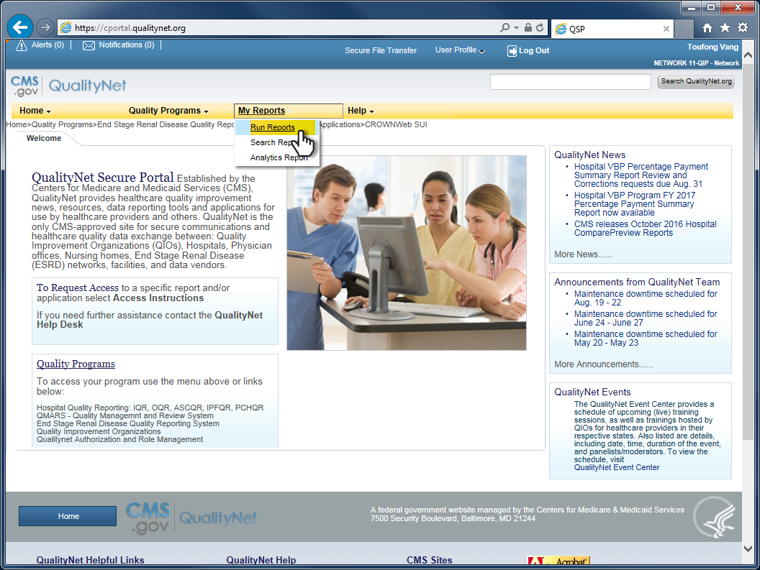
12
To generate or view a Performance Score Report ...
Click My Reports and select Run Reports.

Slide 13
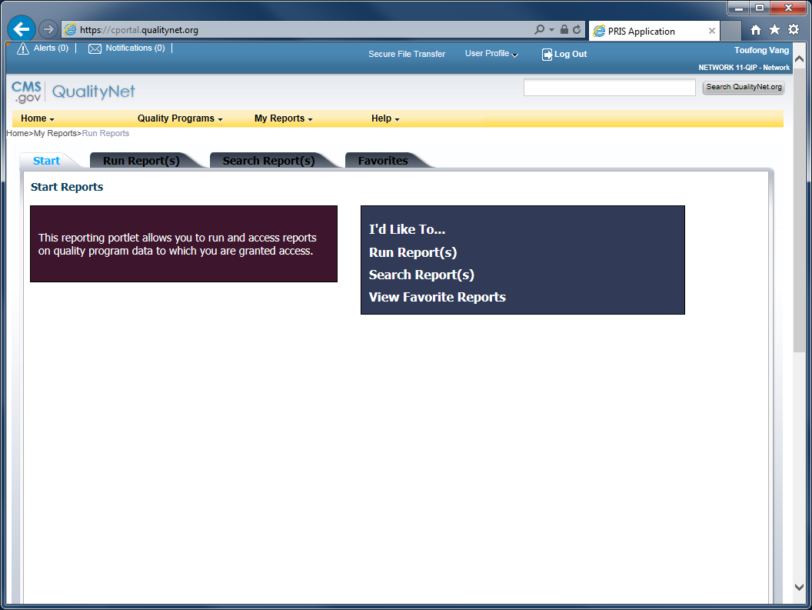
13
The “reporting portlet” loads.

Slide 14
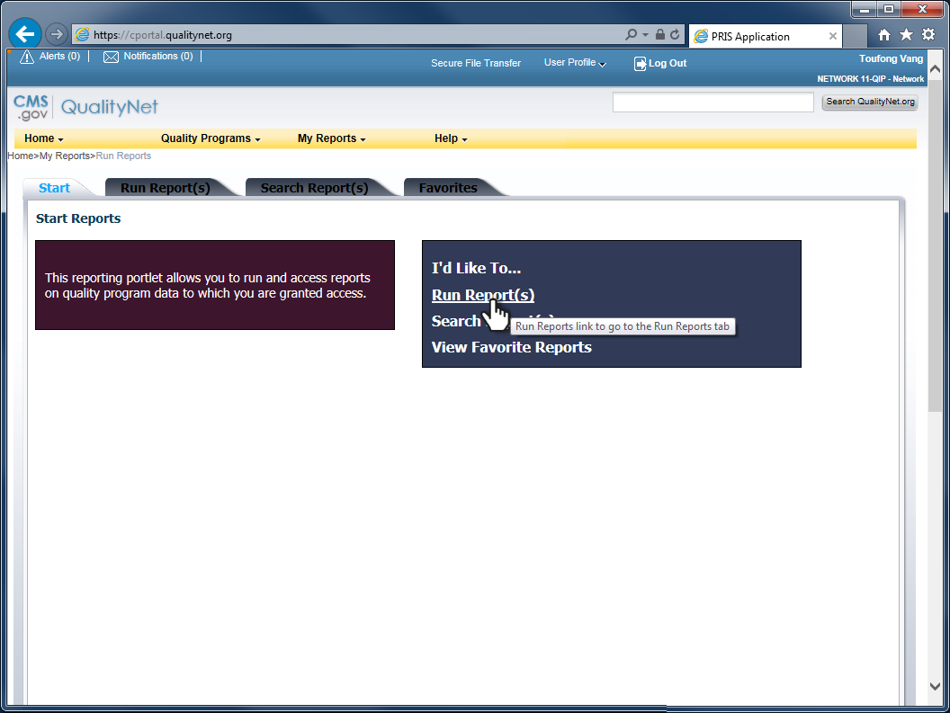
14
Click Run Reports ...

Slide 15
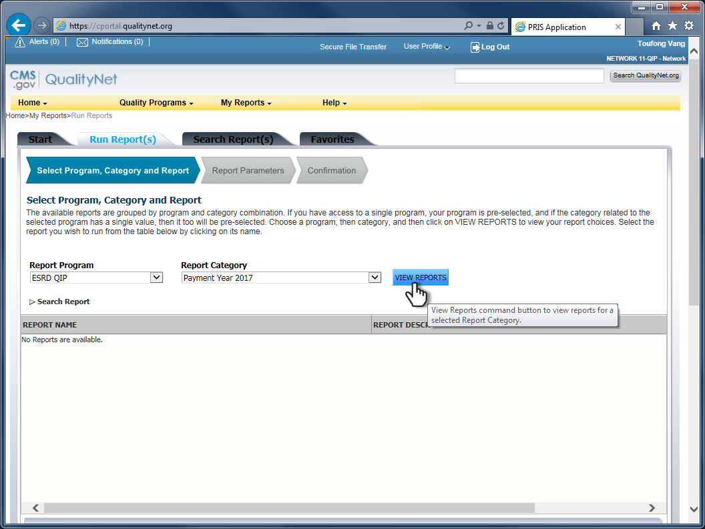
15
After the reports dialog loads...
Click VIEW REPORTS ...

Slide 16
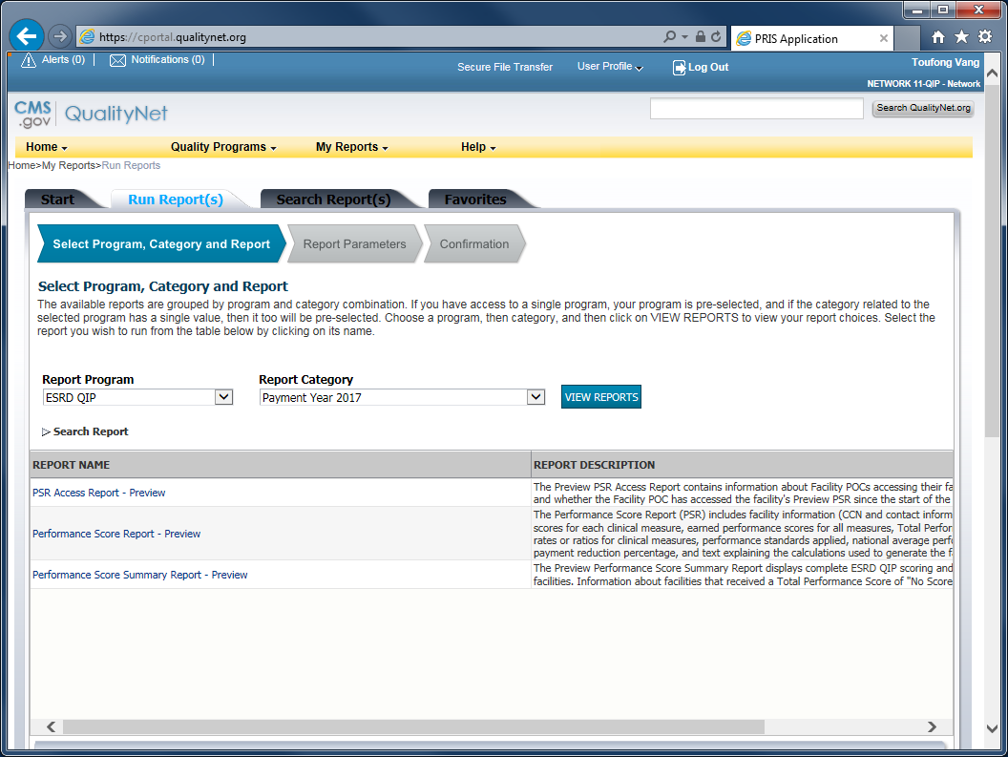
16
...to display the list of reports that are available to your profile.

Slide 17
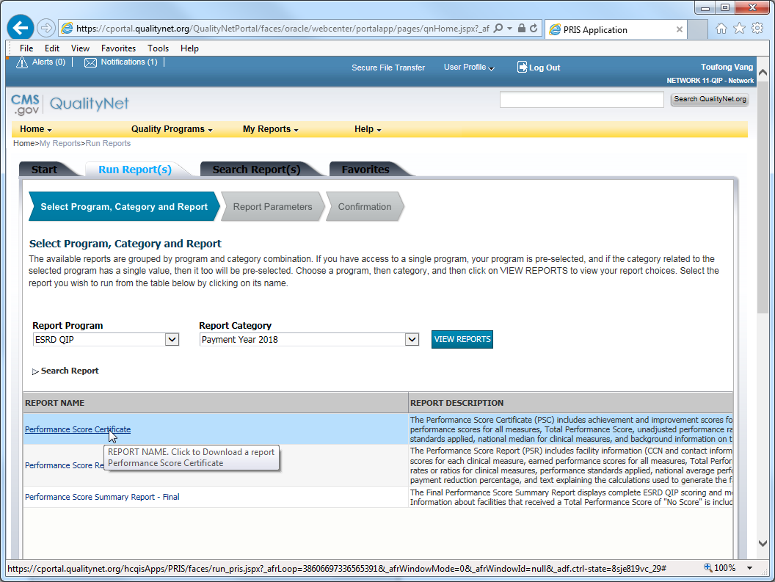
17
Select the report to run.

Slide 18
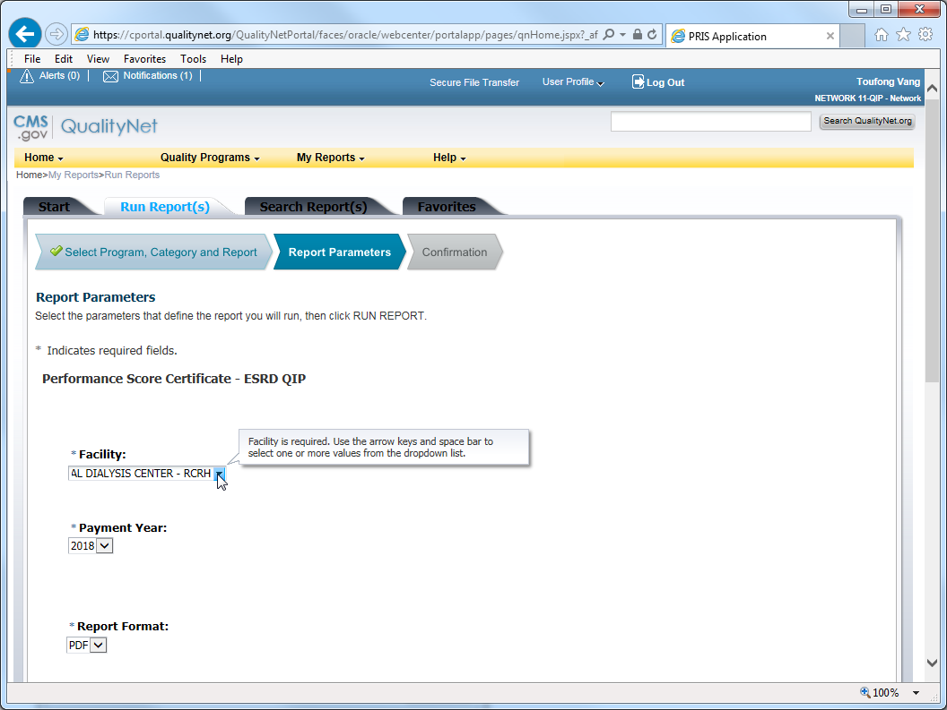
18
Select your facility from the drop-down list in the *Facility field. Be sure to check the box.

Slide 19
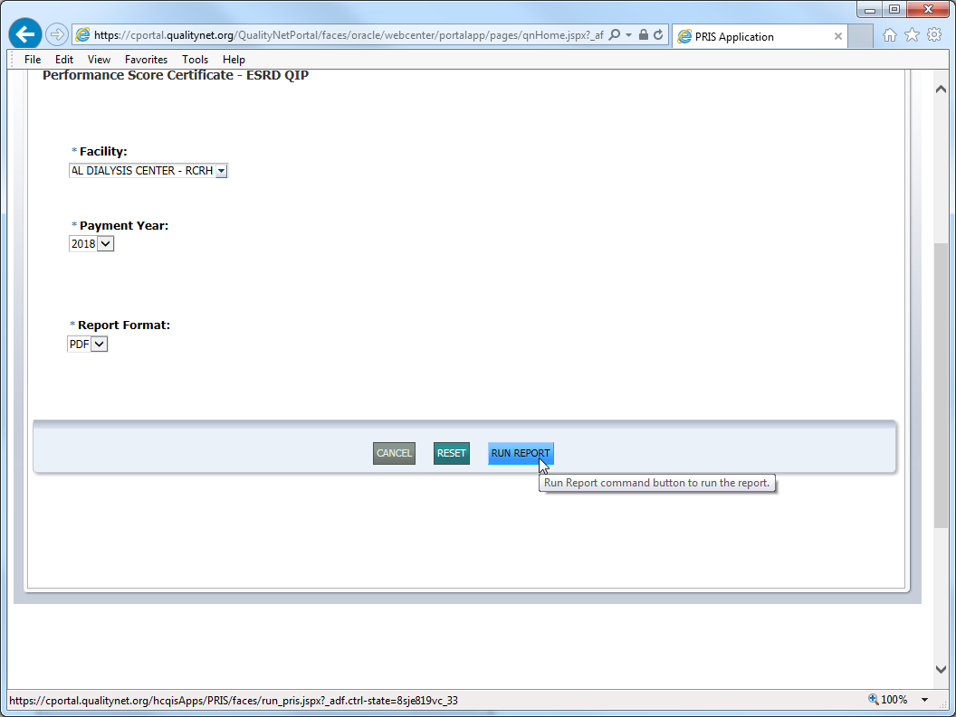
19
Click RUN REPORT.

Slide 20
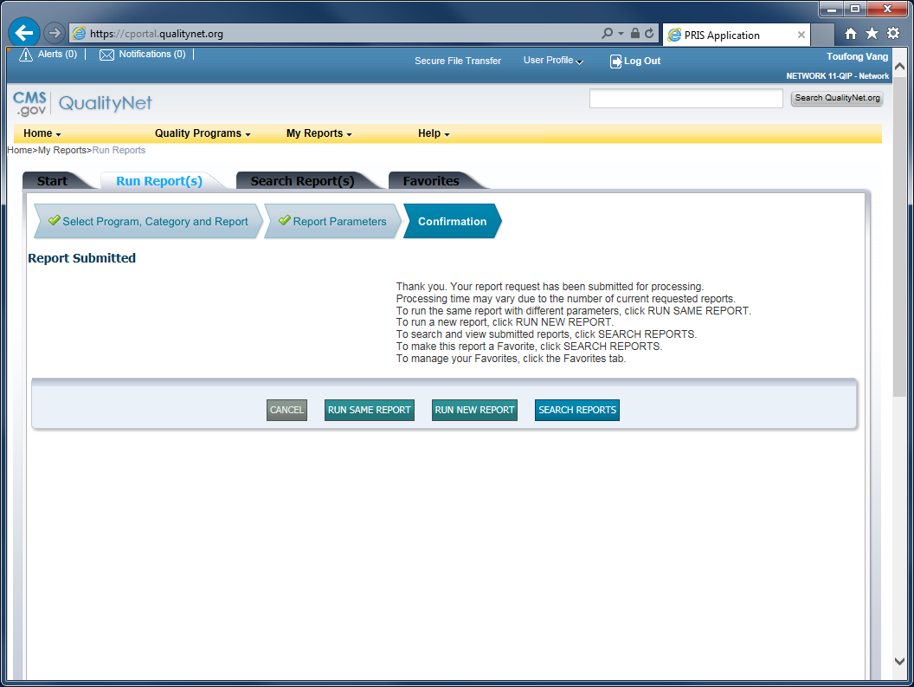
20
ESRD QIP confirmation that the report job was successfully submitted for processing.

Slide 21
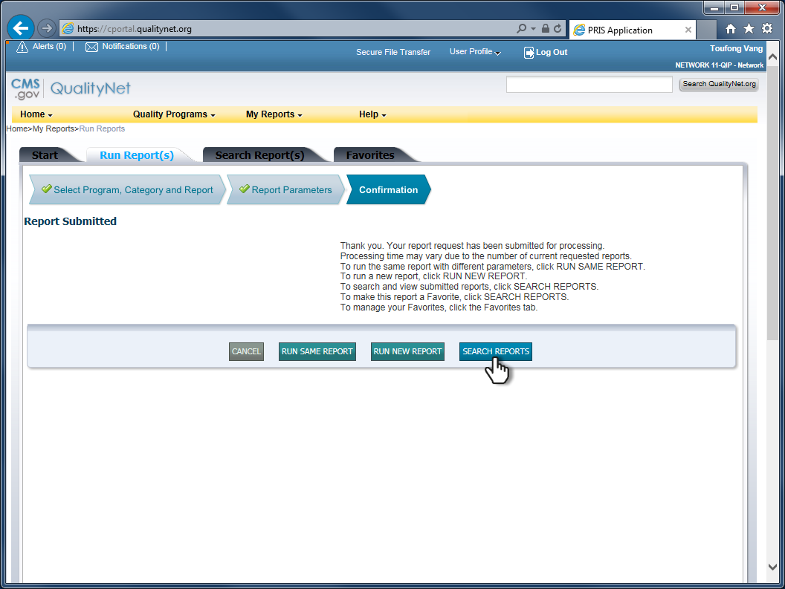
21
Click SEARCH REPORTS to see a list of the reports that you’ve run.

Slide 22
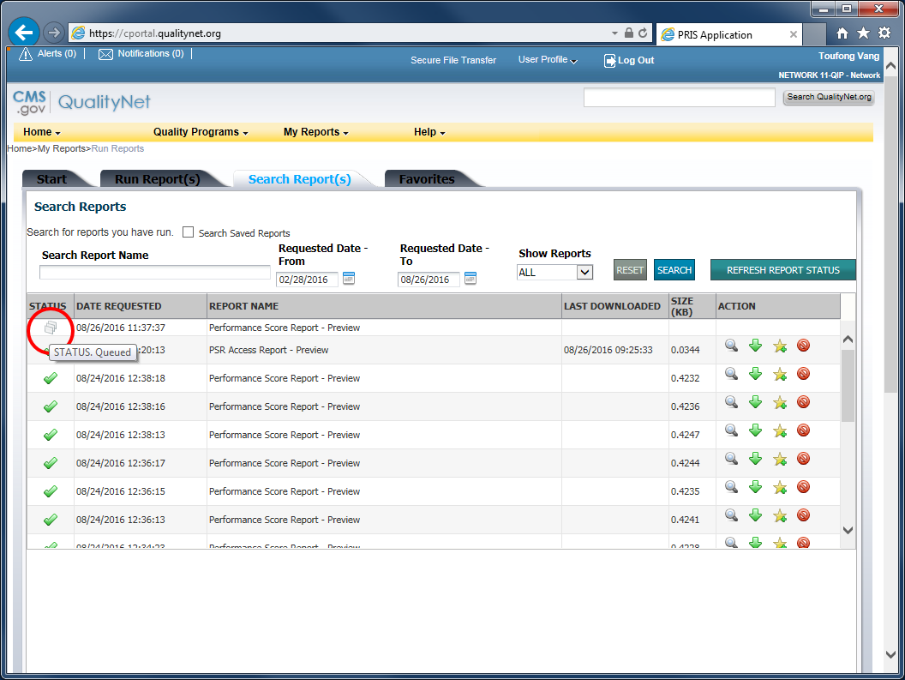
22
The icon that looks like a set of cascading documents indicates that the report is in queue for processing by the server.

Slide 23
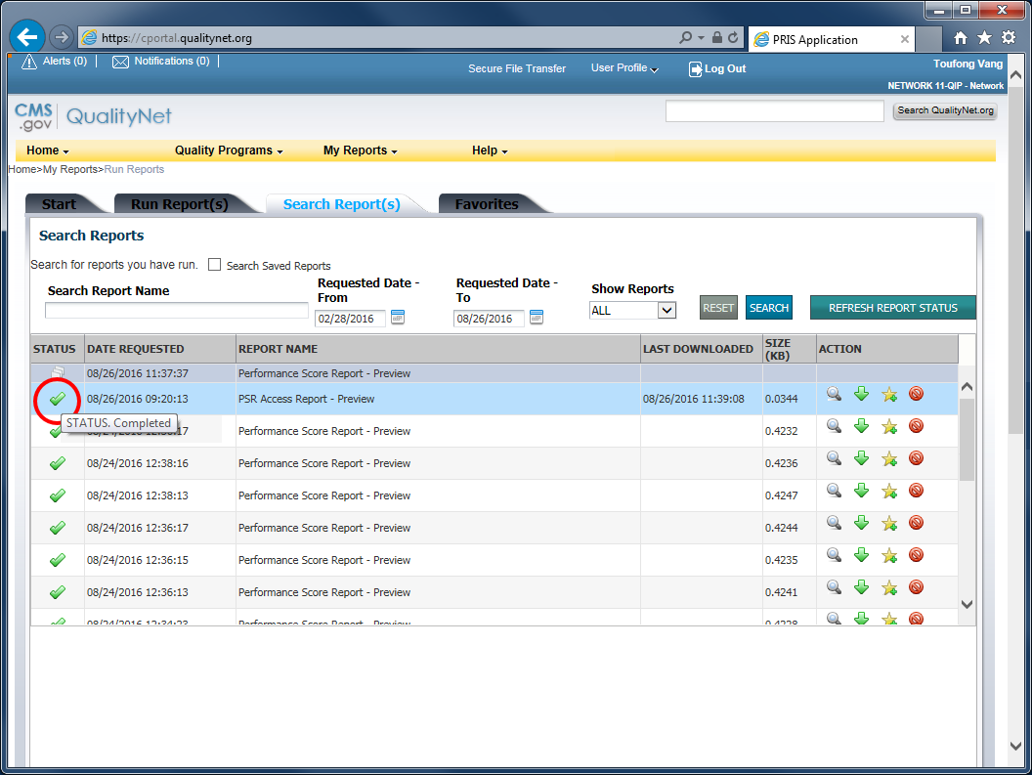
23
The green check mark indicates that the report has successfully run and is ready.

Slide 24
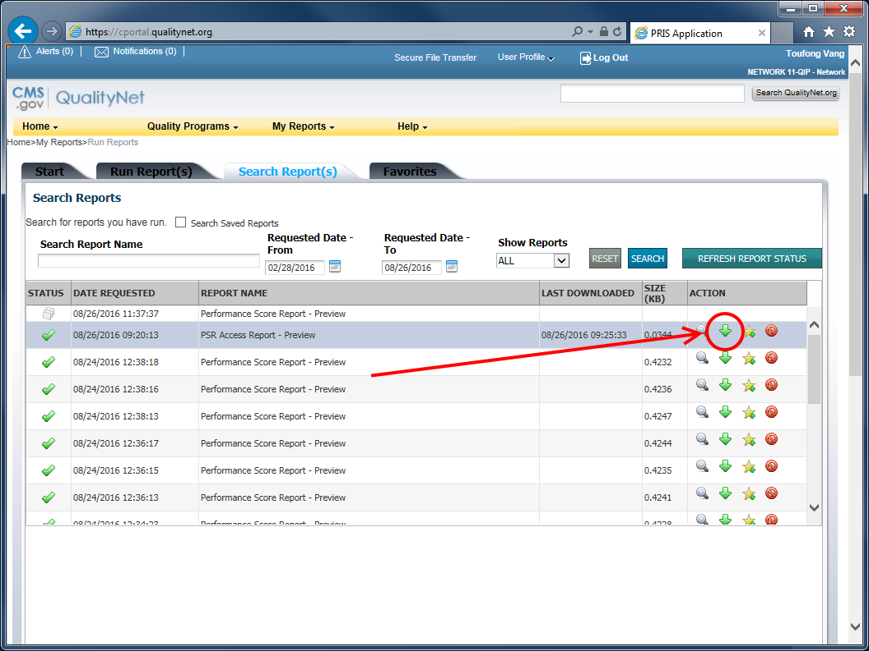
24
Click on the green, down arrow to download the report.

Slide 25
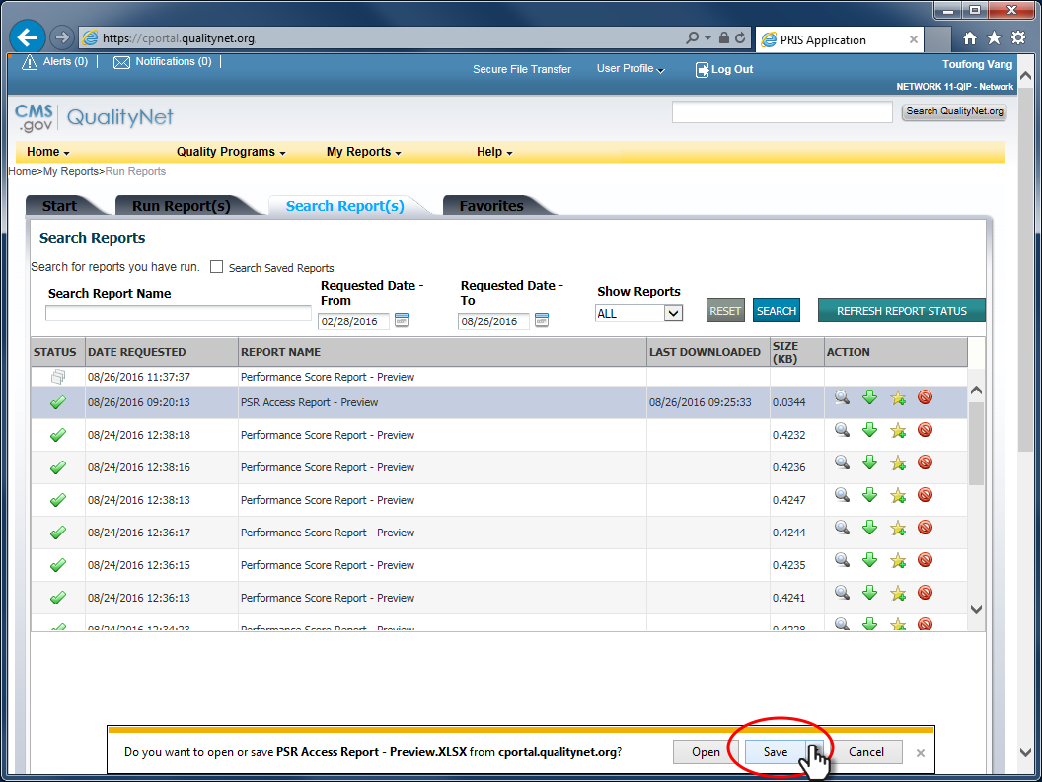
25
Click Save to save the report for offline review.

Slide 26
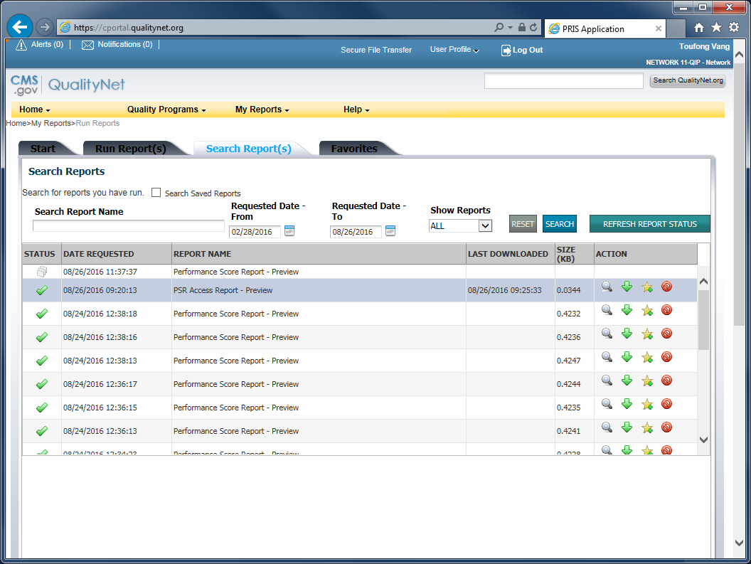
26
Done!

