Slide 1
1
The following slides are screenshots of the process of switching from one CROWNWeb facility to another.

Slide 2
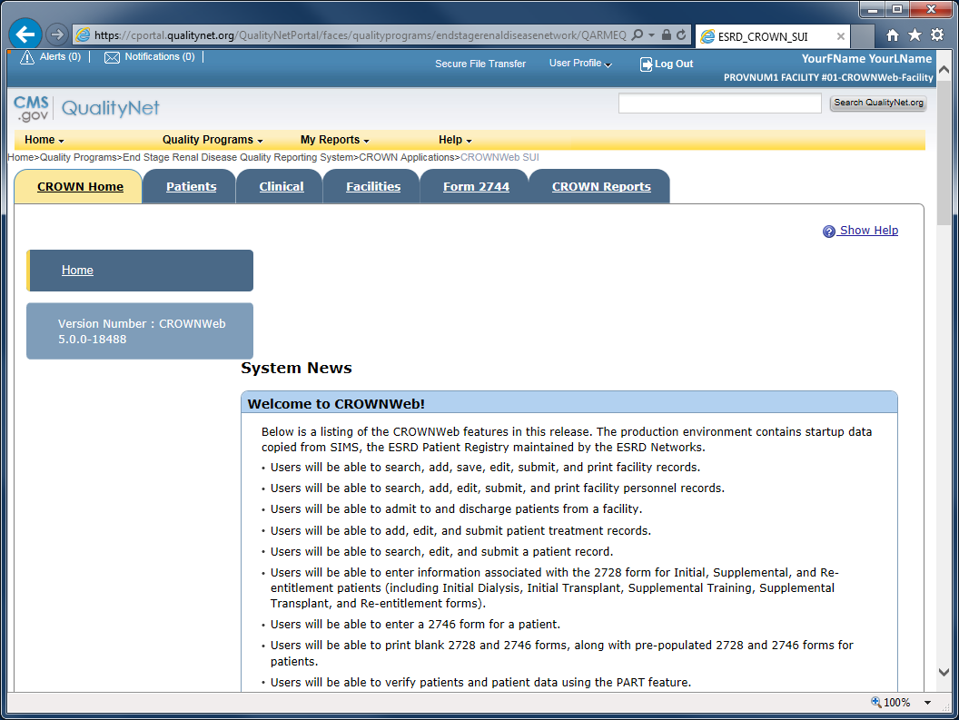
2
From the QualityNet Secure Portal home page or from the CROWNWeb home page...

Slide 3
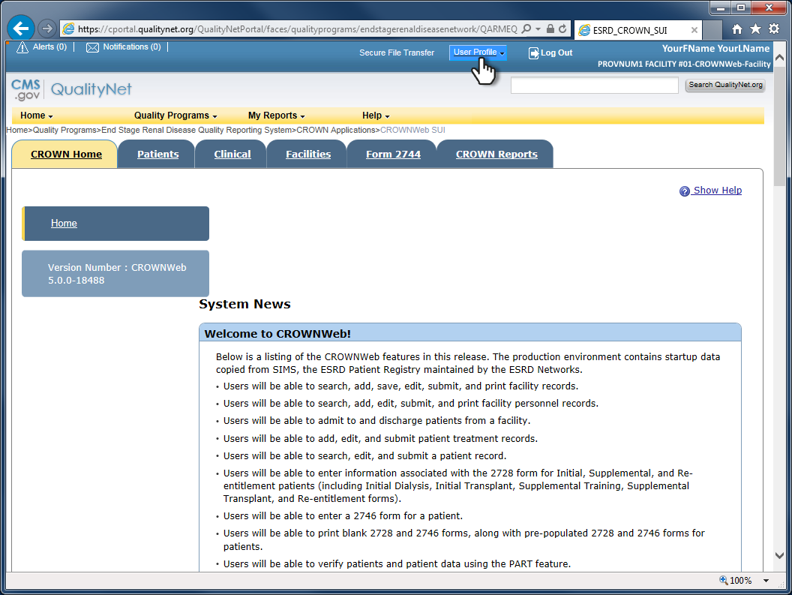
3
...click on User Profile.

Slide 4
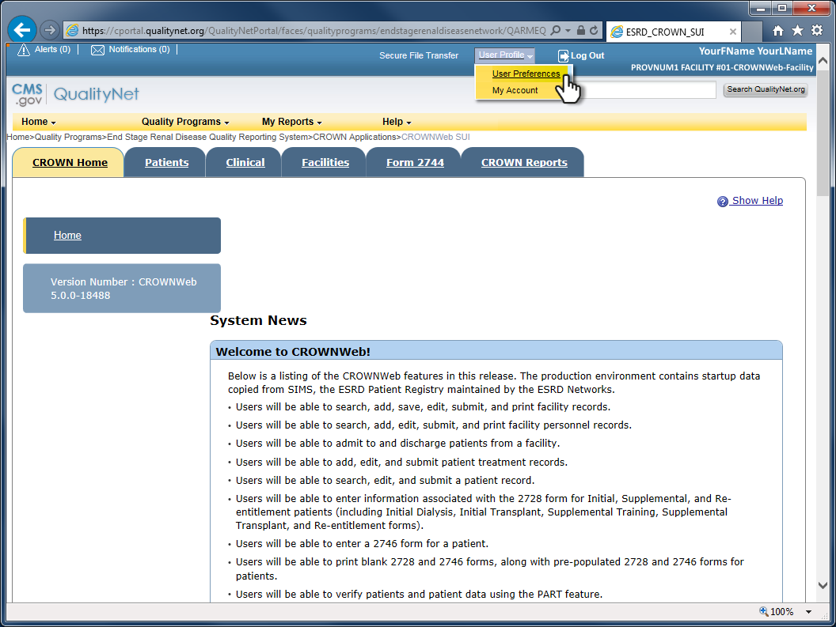
4
Select User Preferences from the drop-down list.

Slide 5
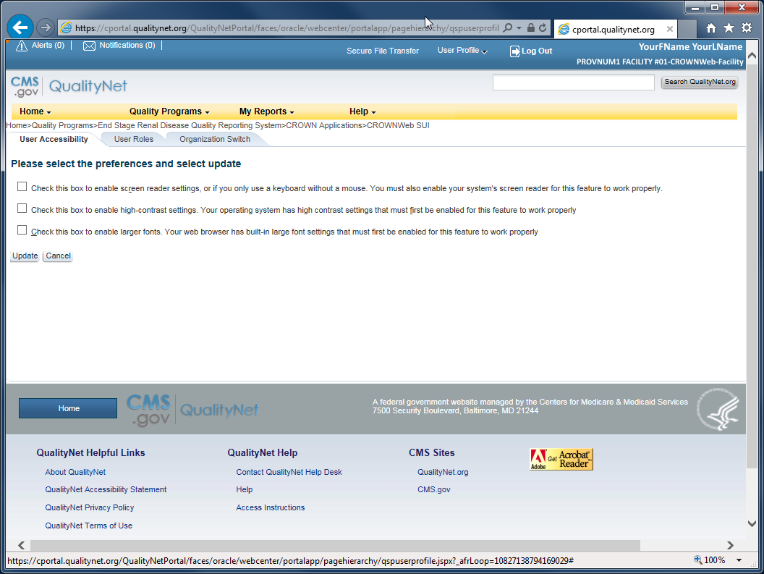
5
After the user preferences page has finished loading...

Slide 6
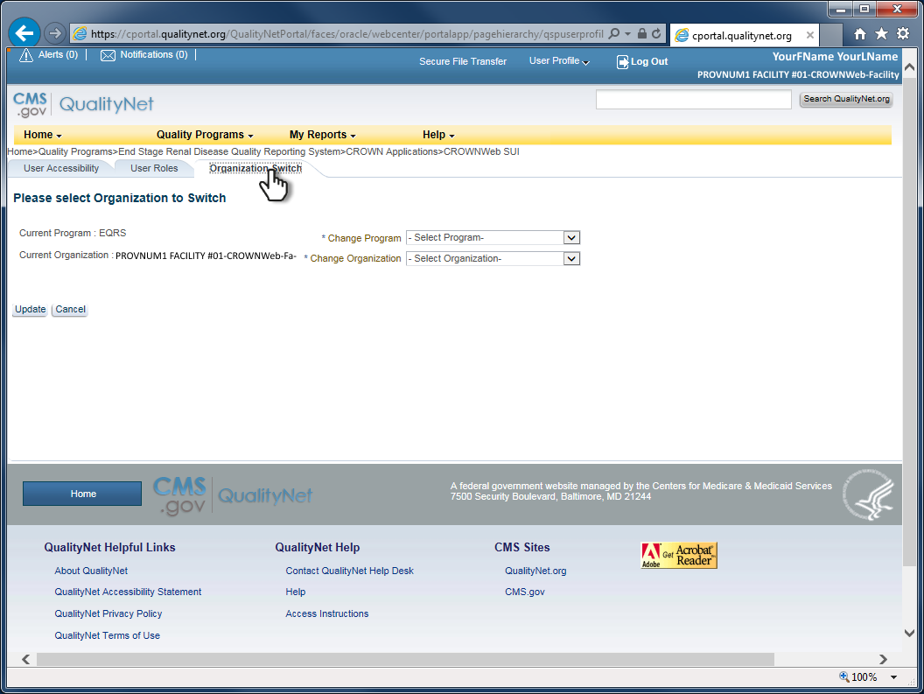
6
...click on the Organization Switch tab.

Slide 7
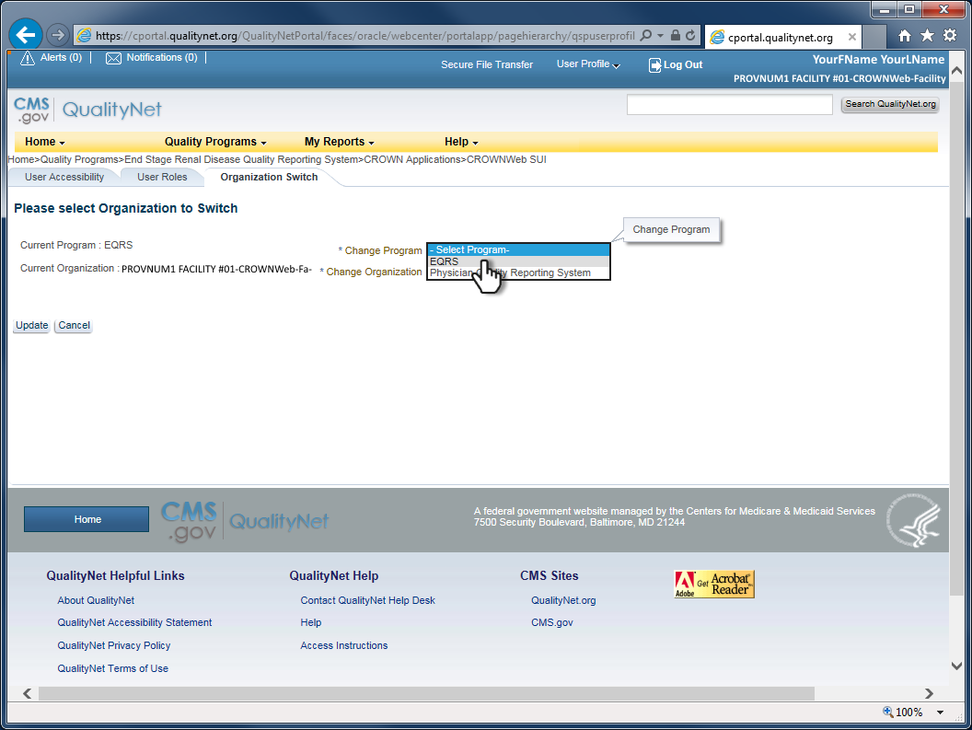
7
Select EQRS from the Change Program drop-down list.

Slide 8
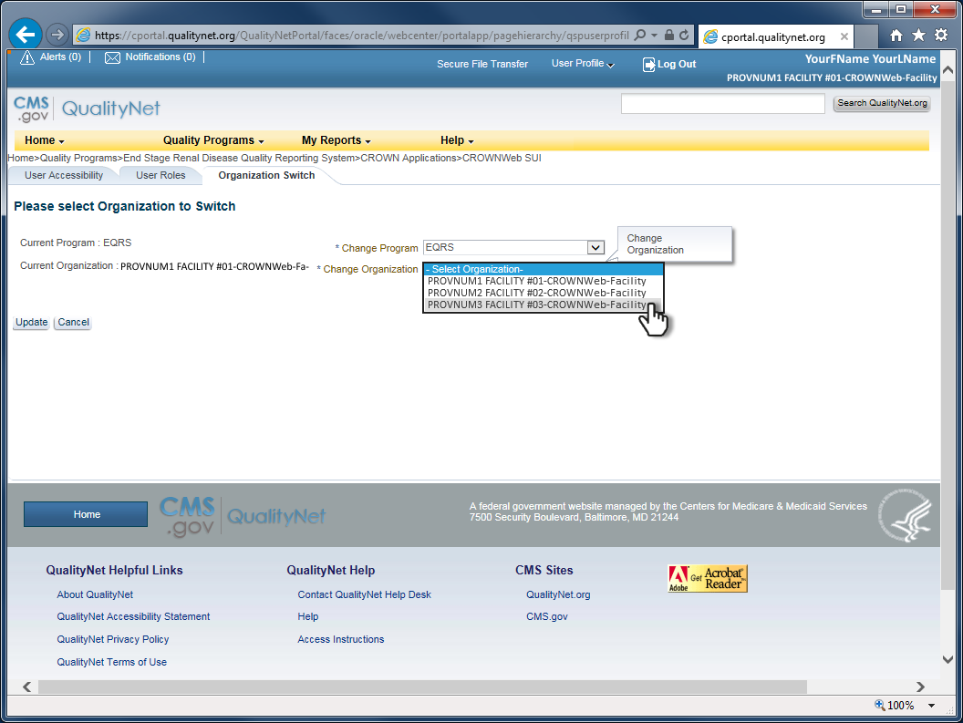
8
Select the desired facility from the Change Organization drop-down list.

Slide 9
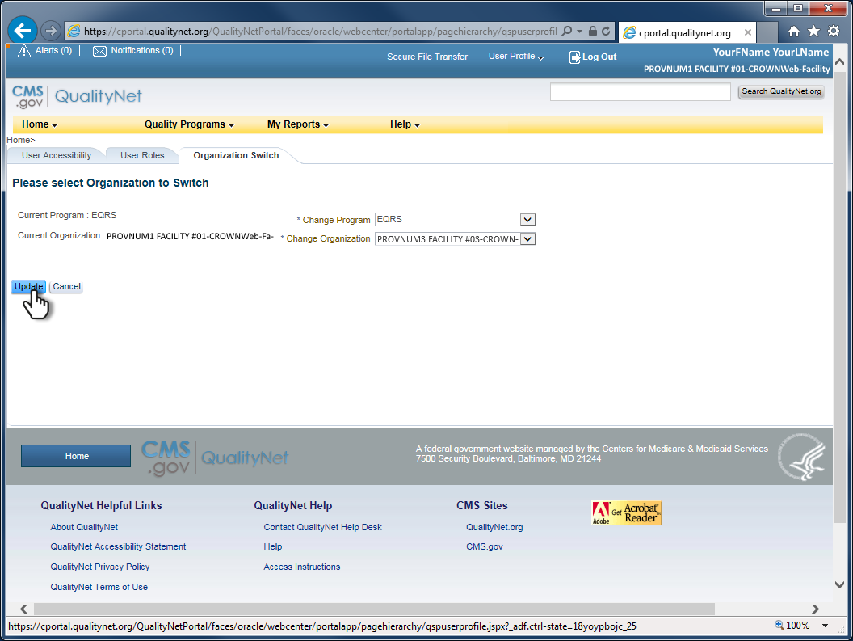
9
Click the Update button.

Slide 10
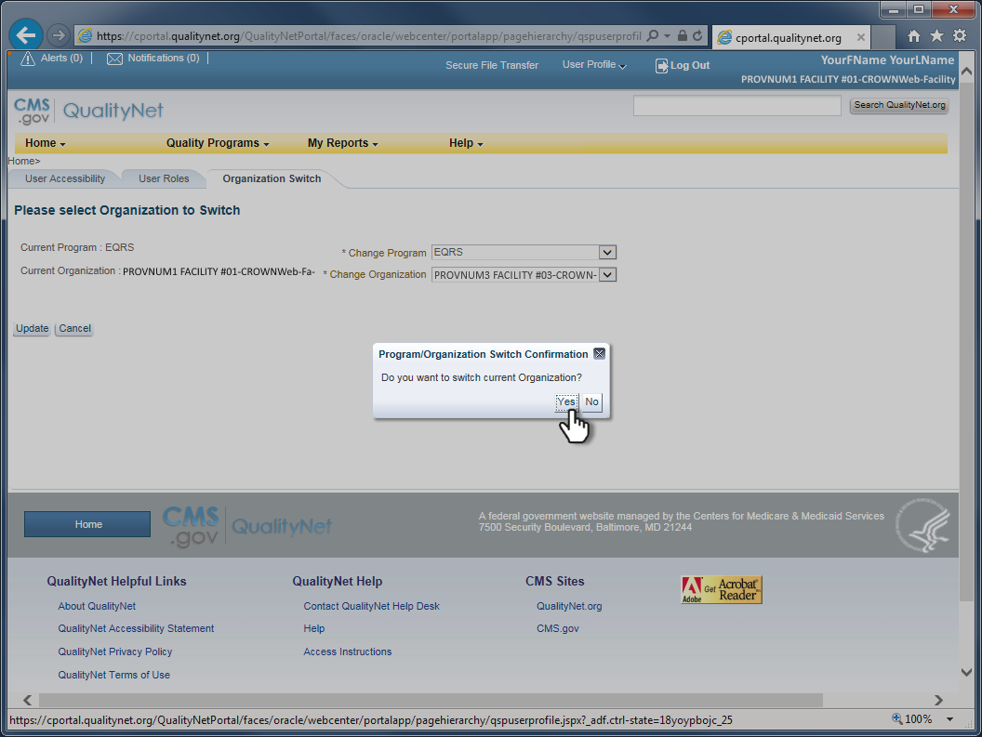
10
Click Yes to confirm and submit the switch.

Slide 11
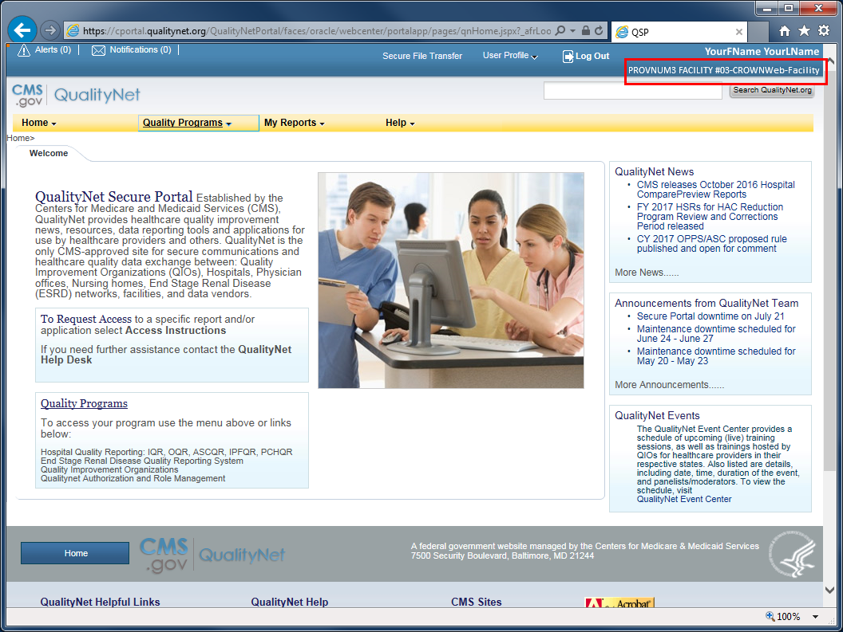
11
A successful switch will return you to the QualityNet Secure Portal home page, and the changed facility indicated in the upper right corner.

Slide 12
12
Connect to CROWNWeb...
Quality Programs > End Stage Renal Disease Quality Reporting System > CROWNWeb SUI

