Slide 1
1
The following slides are screenshots of the process of requesting access to CROWNWeb.
The steps demonstrated in these slides are also used for requesting ESRD QIP roles and the QARM Organization Security Official role.

Slide 2
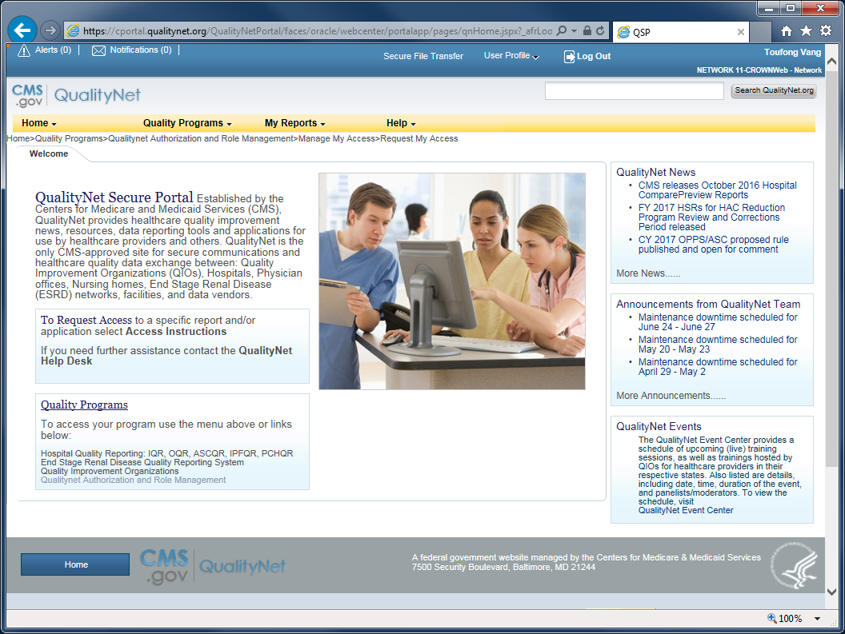
2
From the QualityNet Secure Portal home page...

Slide 3
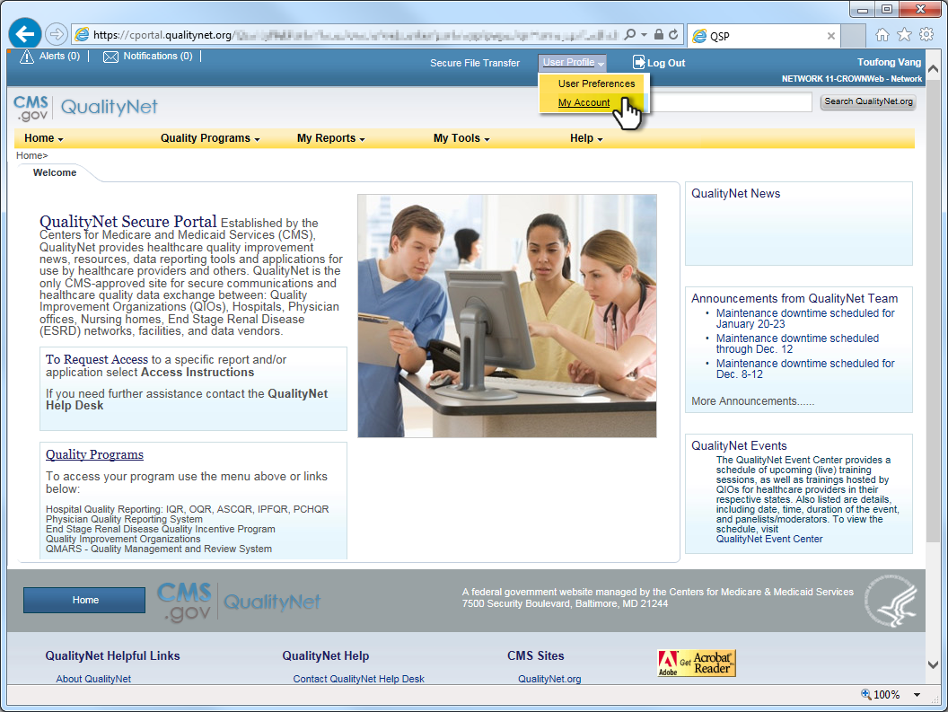
3
...click User Profile and select My Account from the drop-list.

Slide 4
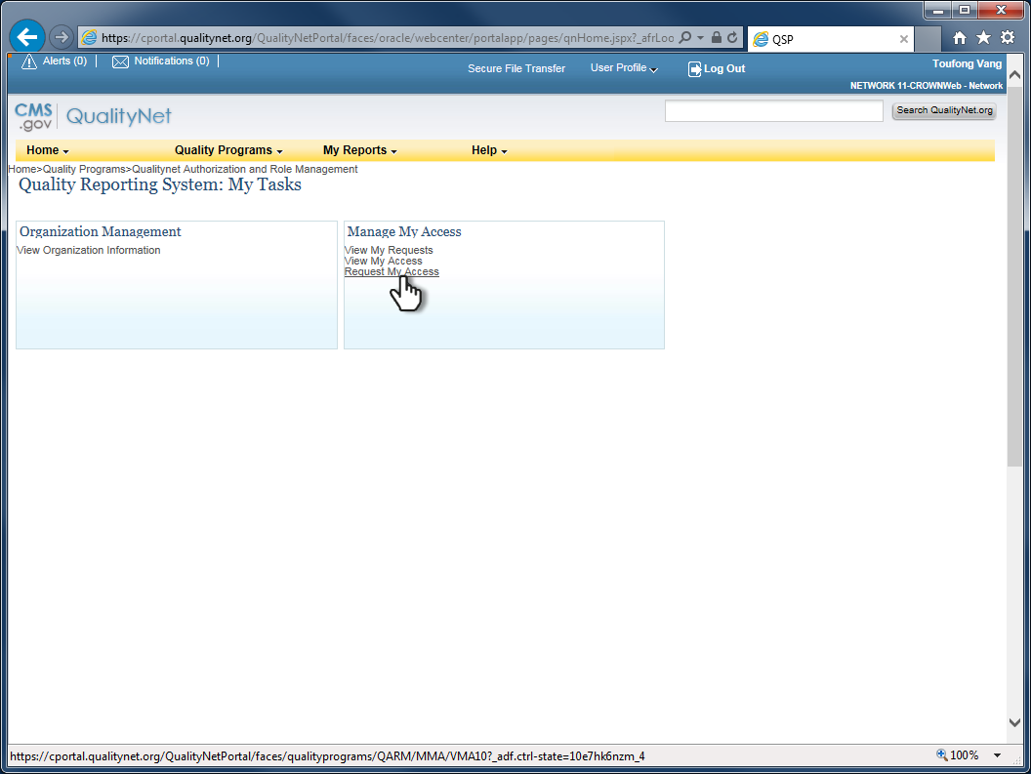
4
Click on the link, Request My Access, to load the access request form.

Slide 5
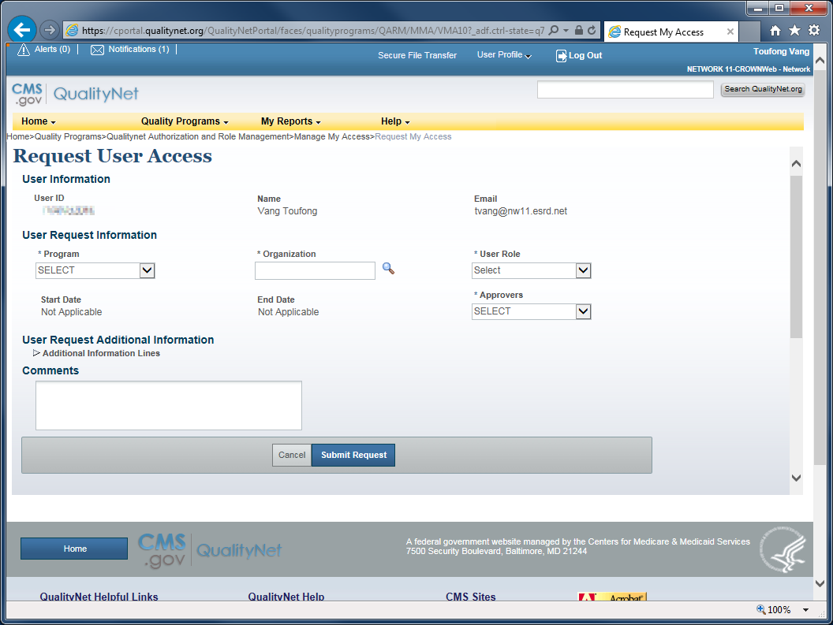
5
Access request form.

Slide 6
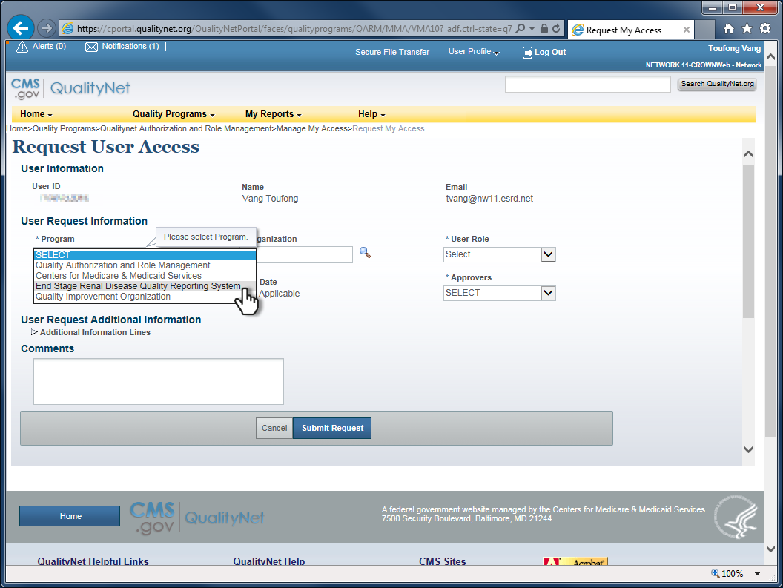
6
Click Program and select End Stage Renal Disease Quality Reporting System from the list.

Slide 7
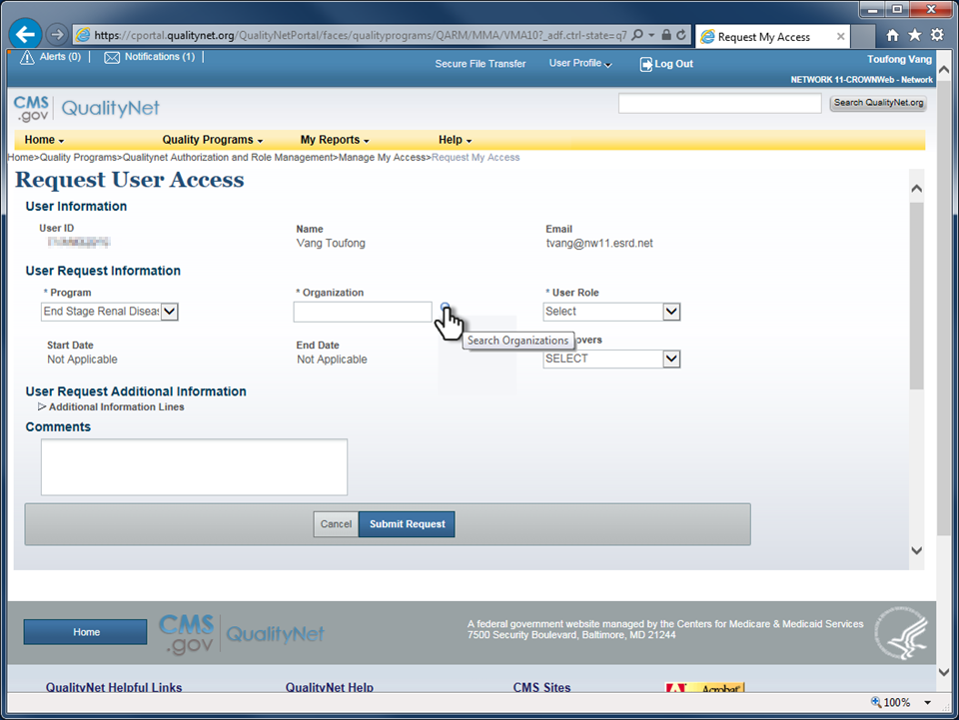
7
Click on the magnifying glass next to the Organization field to search for the organization.

Slide 8
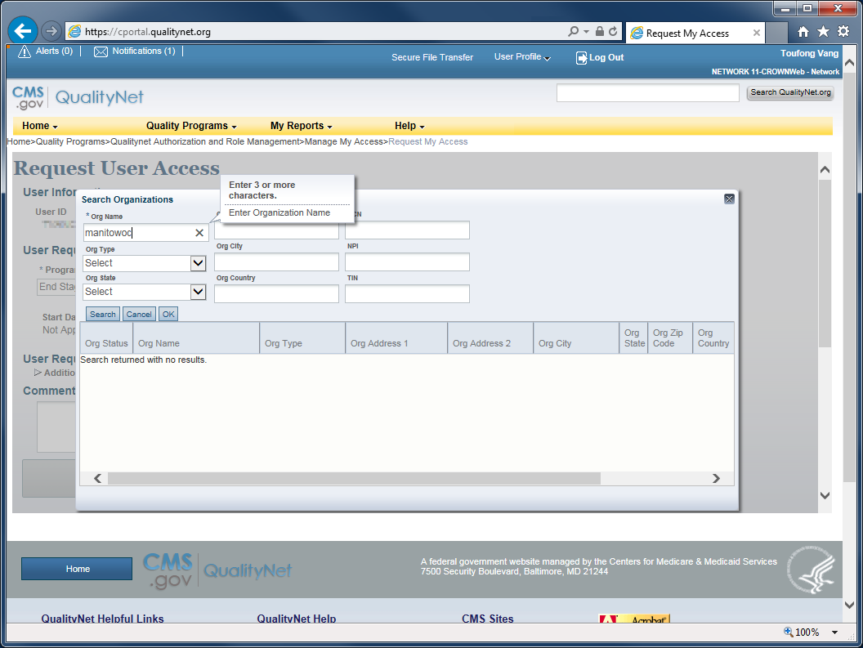
8
Enter the facility name in the Org Name field. (Partial name will work.)

Slide 9

9
Enter the facility’s Medicare certification number(CCN) into the CCN field and then click Search.

Slide 10
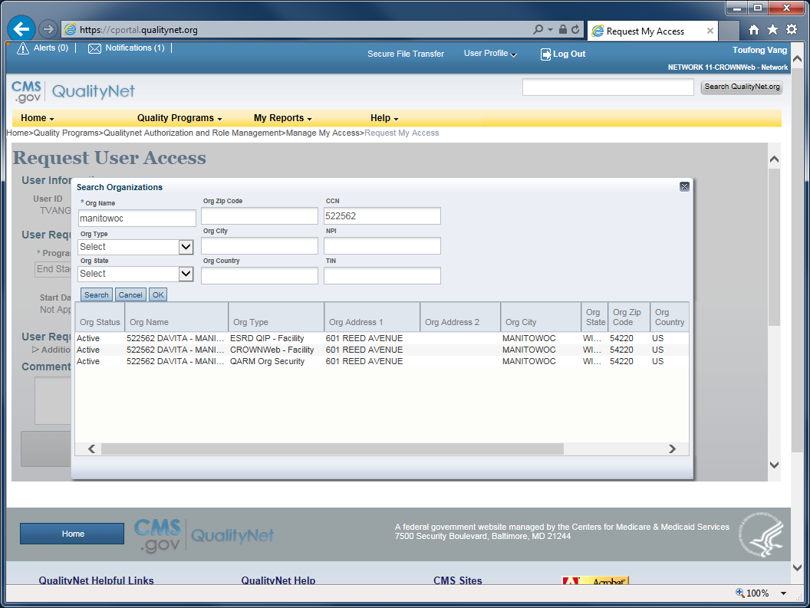
10
Review the search results.
Org Type refers to the EQRS information systems that are available to users at the dialysis facility.
ESRD QIP – Facility: To access QIP Performance Score Report, certificate, etc.
CROWNWeb – Facility: To access CROWNWeb data.
QARM Org Security: To request the role of Organization Security Official .

Slide 11
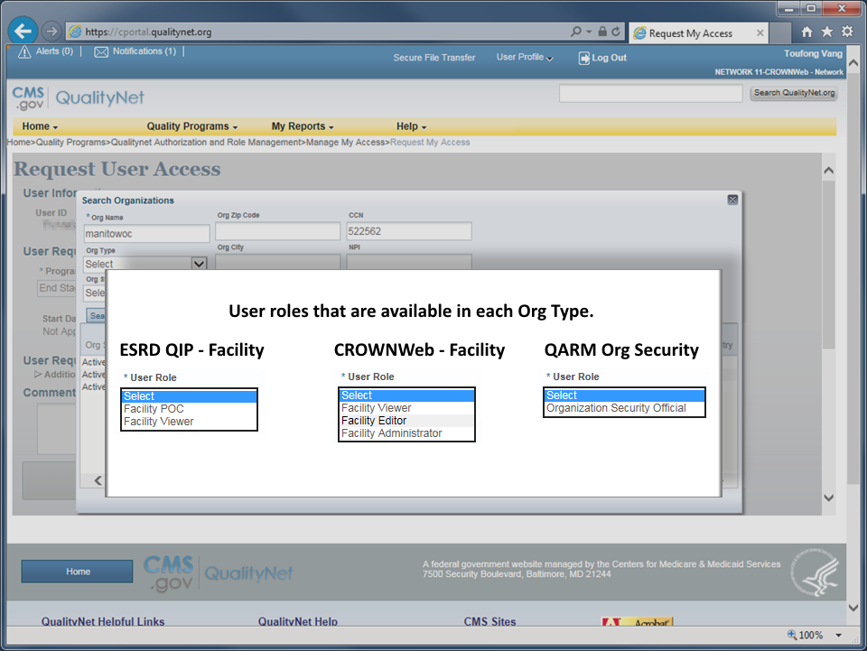
11

Slide 12
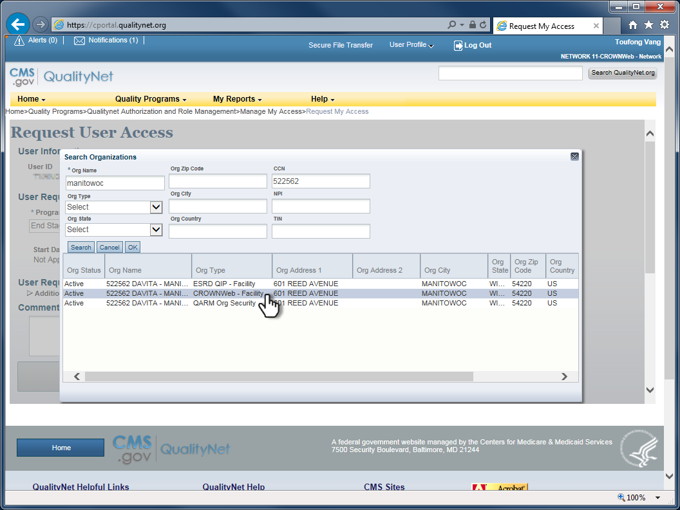
12
In this demonstration, the user will be requesting CROWNWeb access.
Select the Org Type of CROWNWeb – Facility from among the list.

Slide 13

13
Click OK to set the organization name into the access request form.

Slide 14
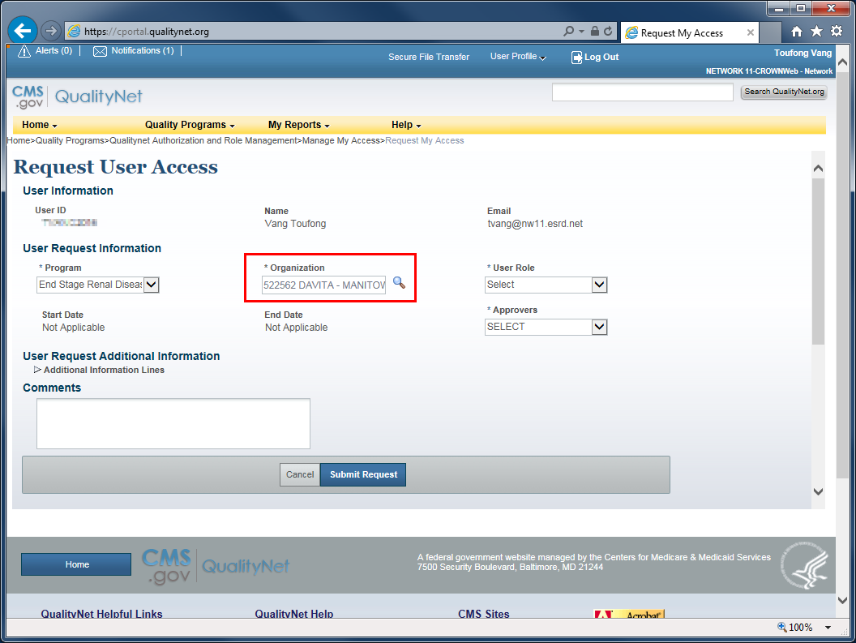
14
Org Name is set.

Slide 15
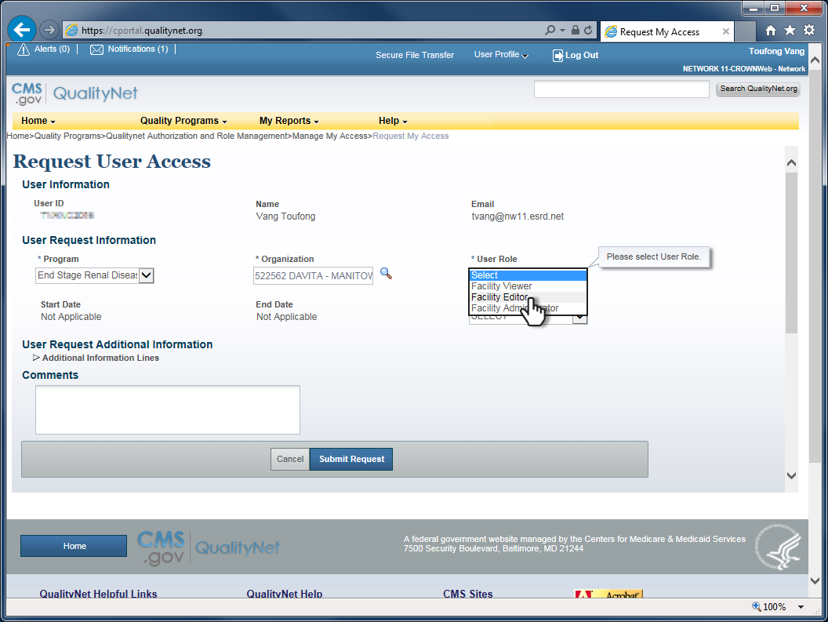
15
Set User Role to Facility Editor.

Slide 16
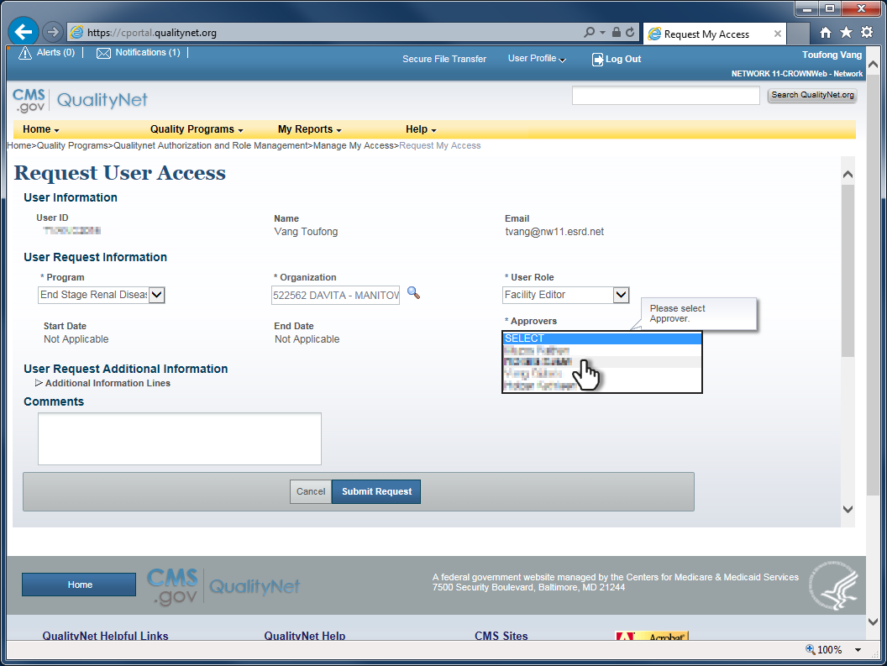
16
Select an Approver . Anyone listed can approve the request, but the person selected will receive notification from QARM when the request is submitted.

Slide 17
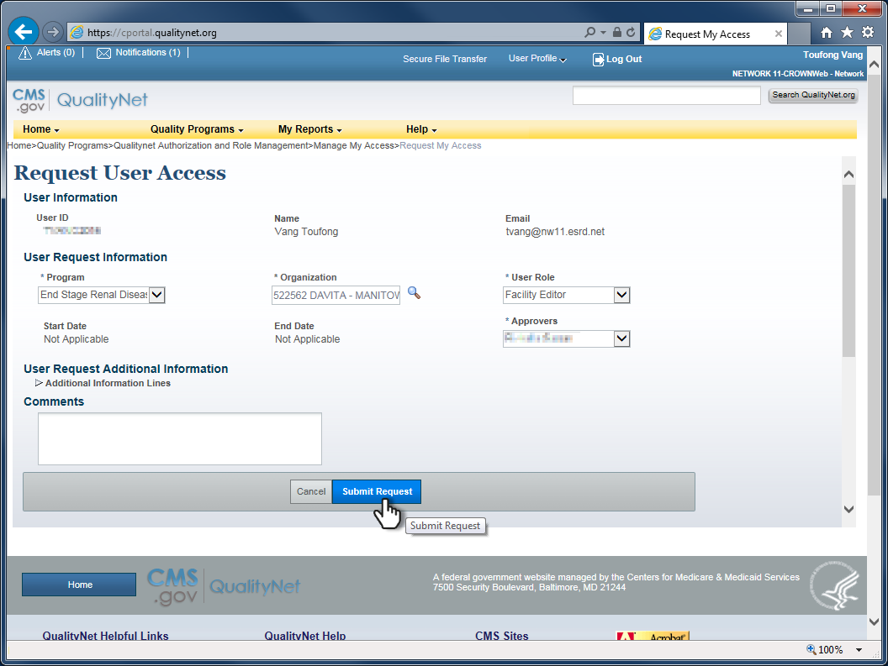
17
Review the completed form.
Click Submit Request.
Confirm the request and click OK.

Slide 18
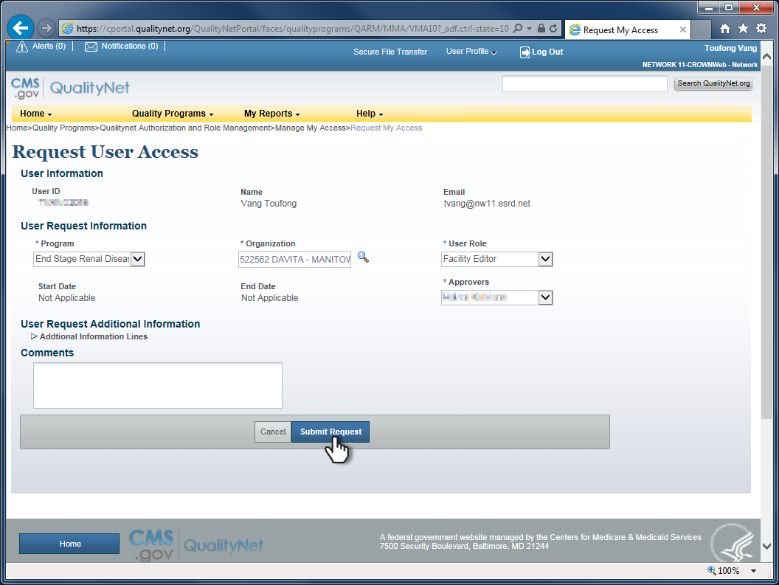
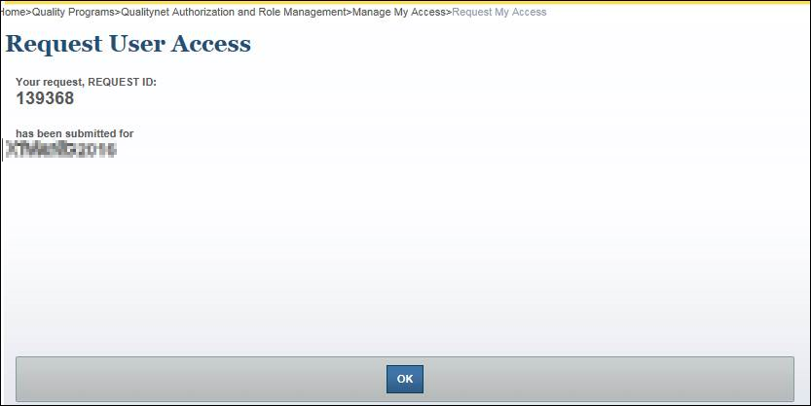
18
Record the request ID number.
Click OK to return to the access request form.

Slide 19
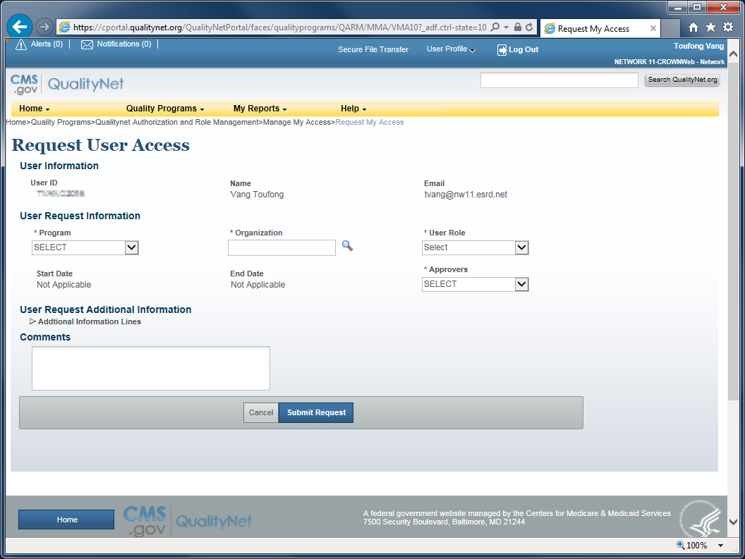
19
Done!

